Slide 1
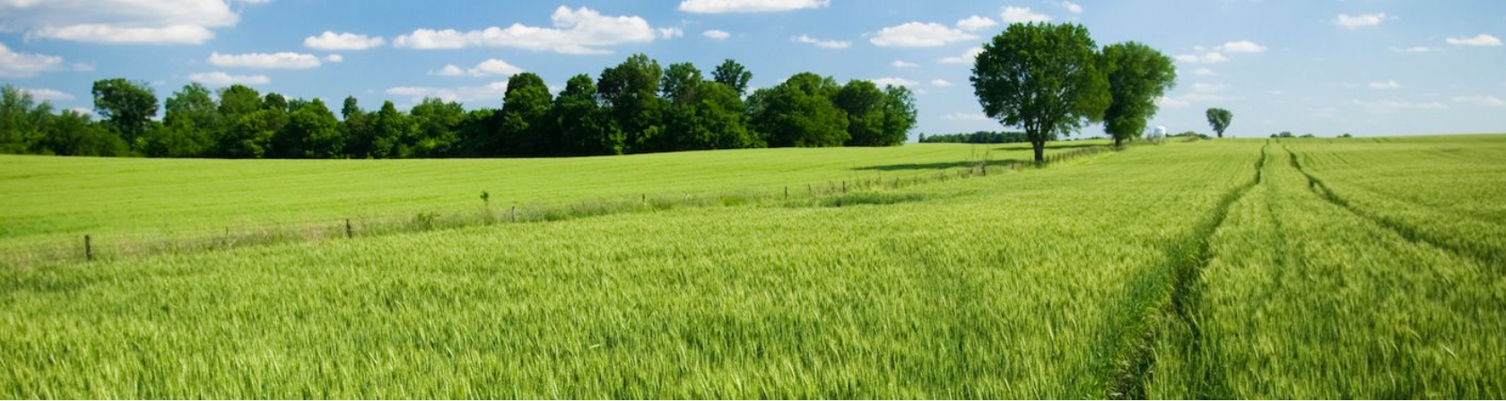

KPDI Update and Techniques to Market Community Assets
Kentucky Economic Forum | November 3, 2022

Slide 2
Site Selection Group

Slide 3



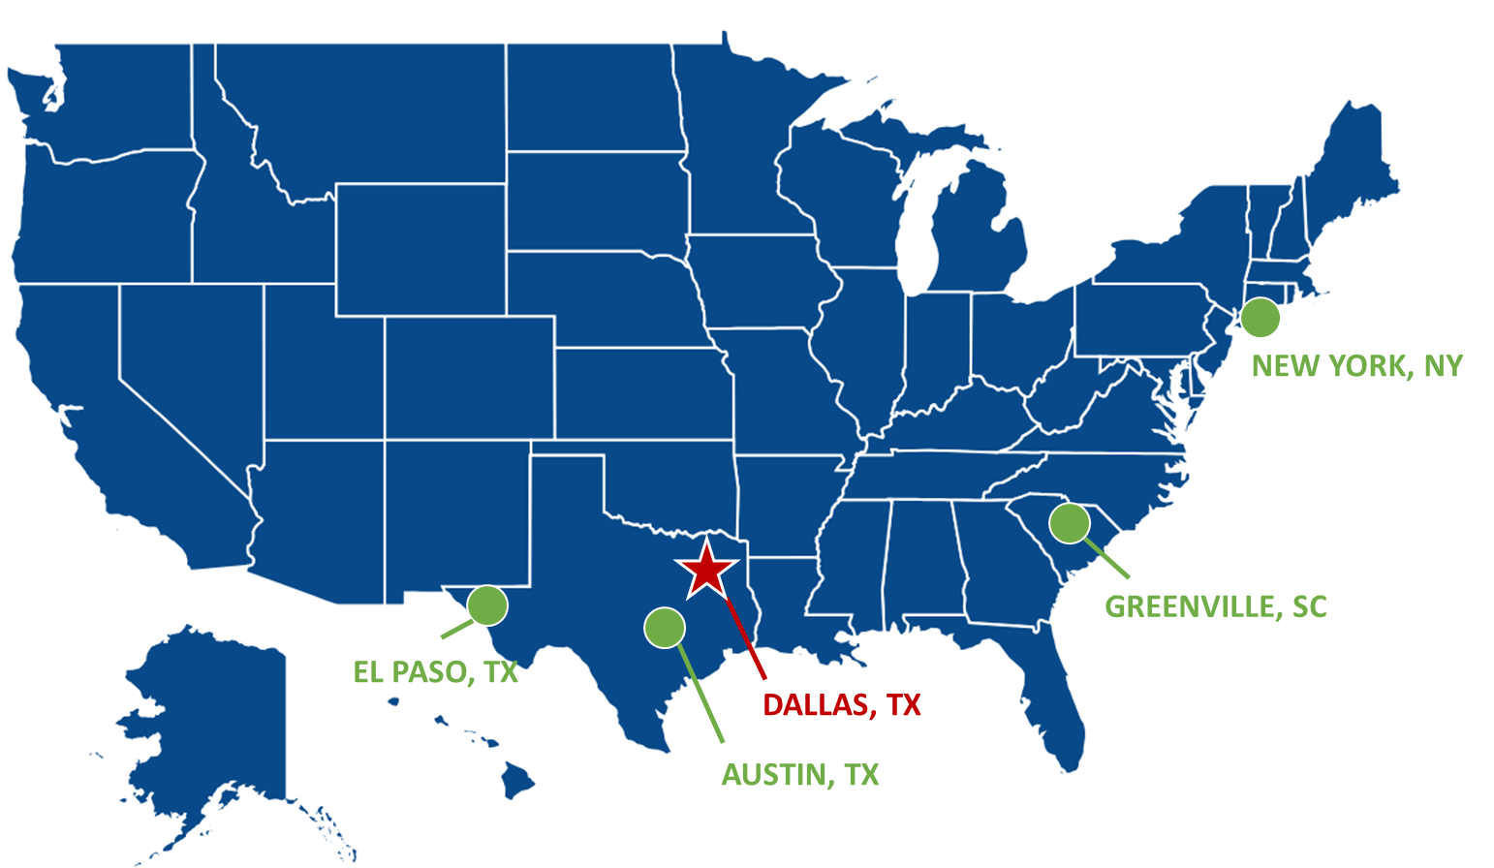


Our Company
40+
Employees
largest independent site selection firm in the U.S.
50+
Full-Service
Projects
completed each year
$283M
Real Estate
transaction value in 2021
Core Services
Location Advisory Services
4.3M
Square Feet
real estate transactions completed in 2021
30+
Fortune 100
Companies
represented
$550M+
Discretionary
Incentives
negotiated for our clients
Real Estate
Services
Economic Incentive Services
SSG’s PURPOSE
Enable our clients to make a positive impact in their communities
Economic Development Consulting
SSG’s MISSION
Connecting companies to the optimal locations through integrated service offerings

Slide 4
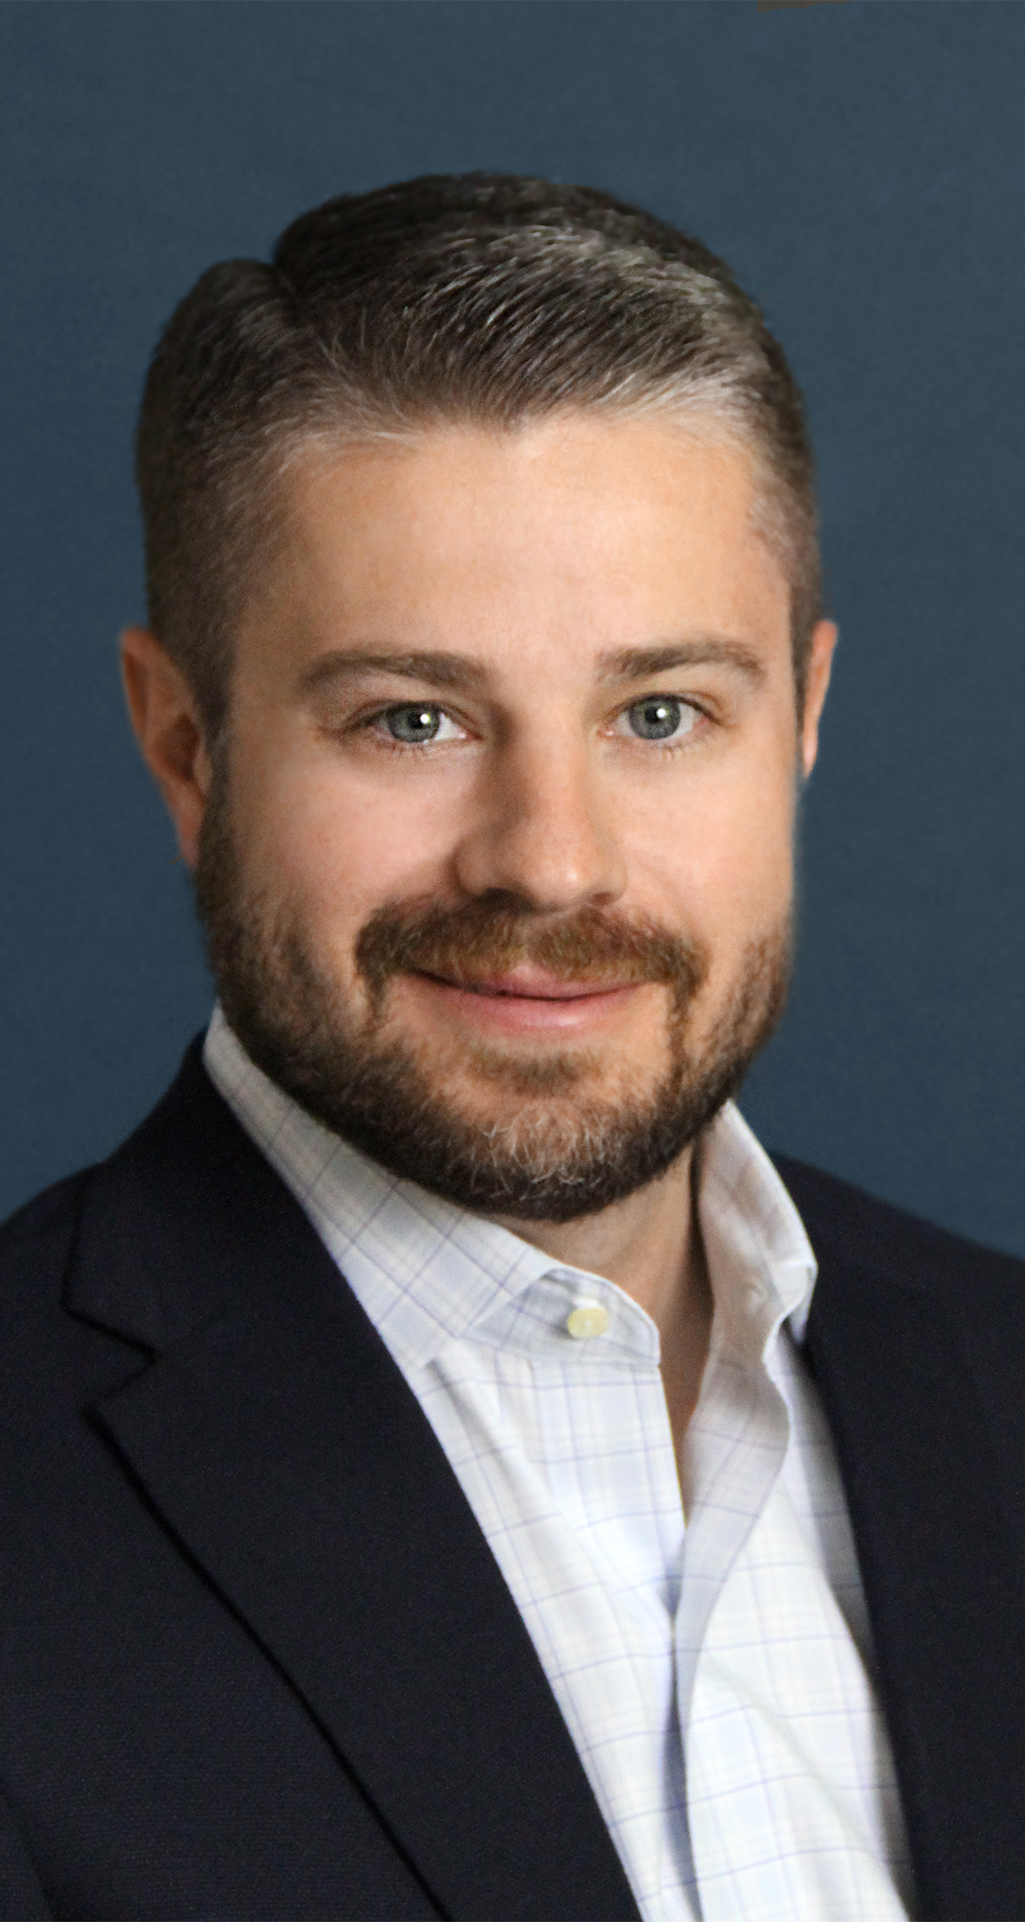
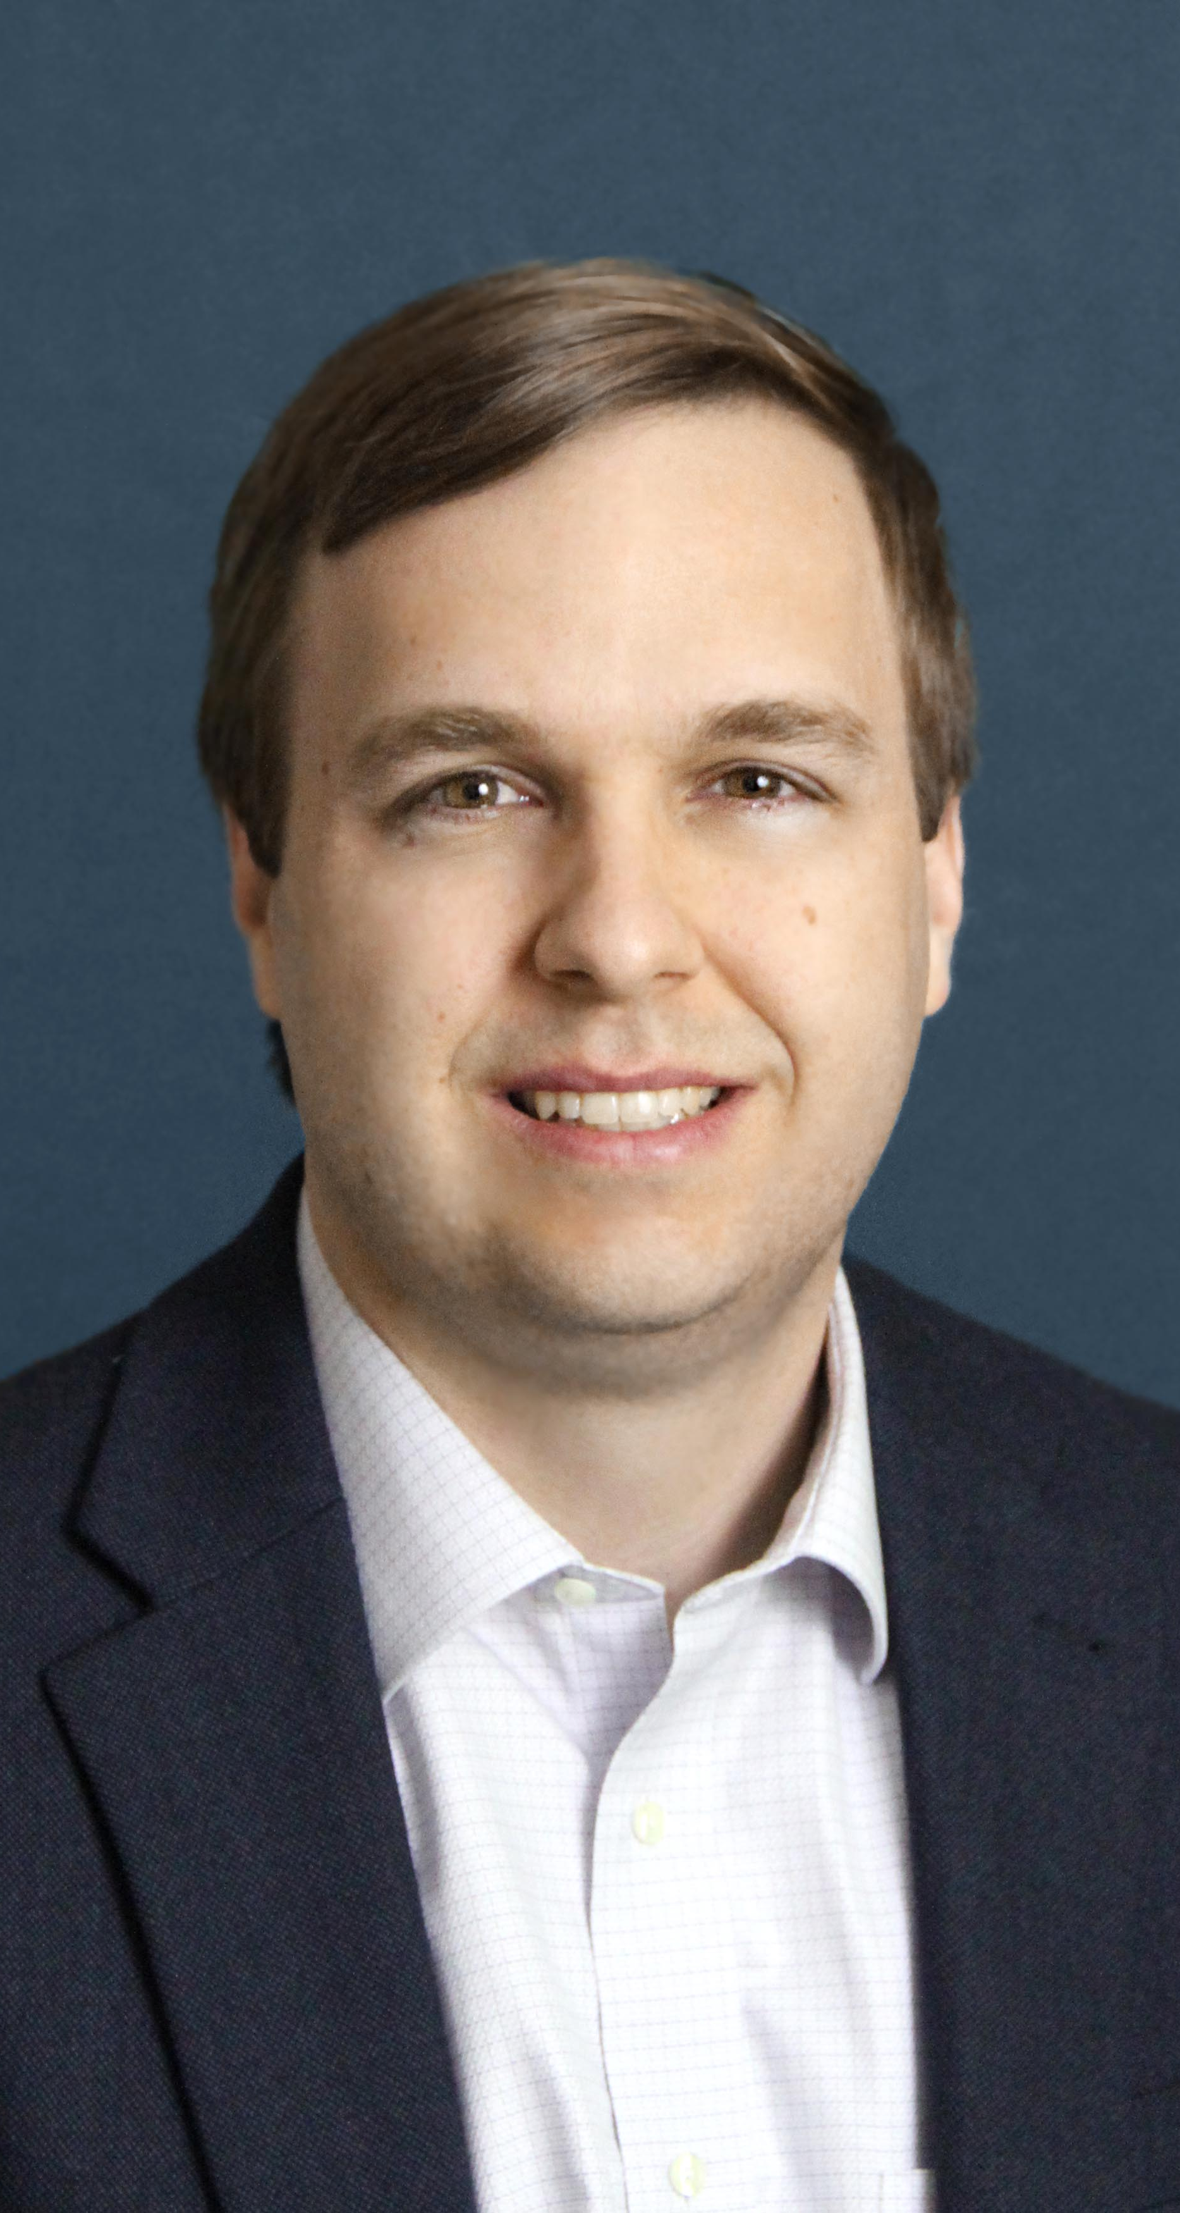

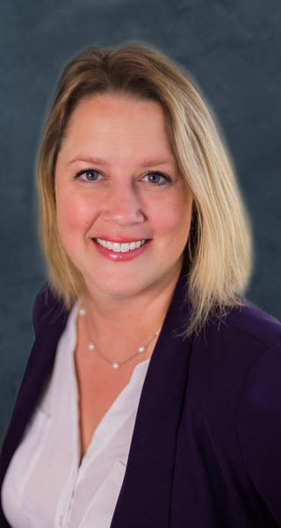

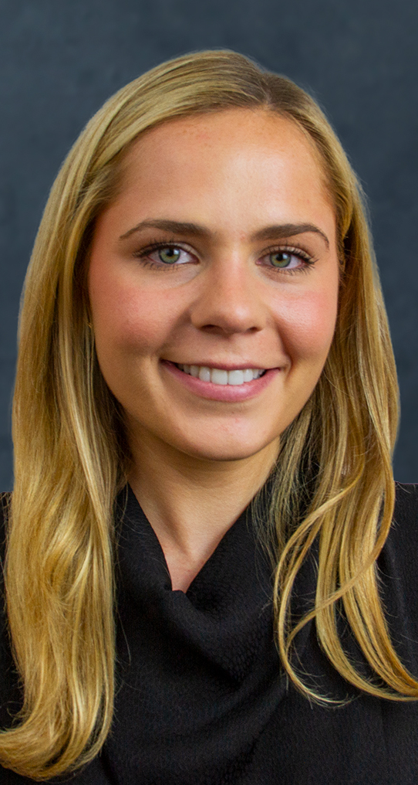
Our Team
Josh Bays
Chris Schwinden
Beth Land
Michaela Martin
Dewey Evans
Ceci Grover
Partner
Senior Vice President
Senior Vice President
Director
Senior Associate
Associate
Industrial Practice
Supply Chain & Logistics
Site & Infrastructure
Project Management
Site & Infrastructure
Workforce & Data Analysis

Slide 5

















































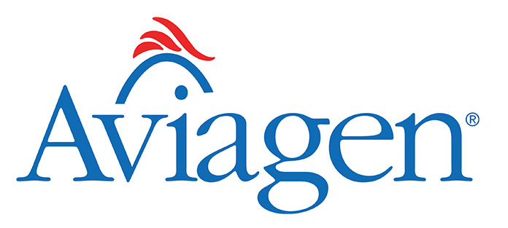







Sample of Recent Industrial Clients
Heavy Industry
Transportation
Food & Beverage
Construction Products
Consumer Goods
E-Commerce & Warehousing
Healthcare, Medical Device, Life Sciences

Slide 6






























And our Economic Development Clients
State & Utility
Regional
Community

Slide 7
2022 Kentucky Product Development Initiative

Slide 8
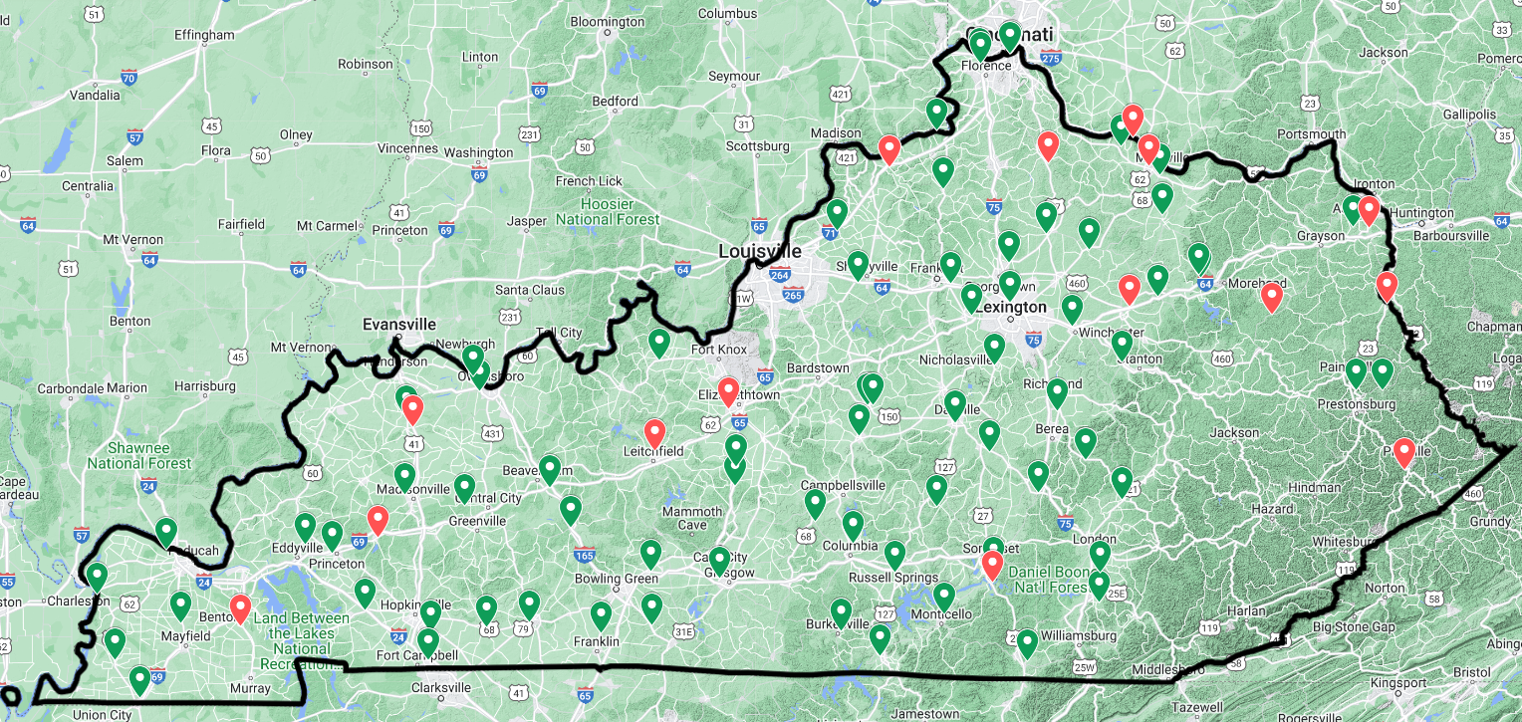


2022 PDI Submission Map
Key Takeaways
89 LOI’s were initially submitted
72 full applications were submitted (currently reviewing)
Represents 65 of 120 counties
Good geographic diversity across the Commonwealth
72 applications (currently reviewing)
17 Withdrawn/Incomplete

Slide 9
Application Results
Primary County | Description of Project | Maximum Allocation | Requested Amount | Total Project Estimate
Adair | Construction of a 150,000 sq ft build-ready pad | 459,441 | 459,441 | 918,000
Allen | Construction of 100,000 sq ft spec building | 500,395 | 215,000 | 430,000
Ballard* | Complete Due Diligence and Site Development work | 305,128 | 405,000 | 4,050,000
Barren | Site Development work | 1,081,215 | 1,081,215 | 4,416,500
Bath | Building acquisition and Infrastructure Improvement | 309,891 | 300,000 | 1,566,440
Boone* | Complete Due Diligence and Site Development work | 5,566,952 | 3,500,000 | 7,400,223
Boone* | Site Development work | 5,566,952 | 2,066,952 | 4,000,000
Boyd* | Acquire private land and create new marketing materials | 2,694,228 | 714,000 | 1,516,500
Boyle | Acquire private land, waterline extension, road improvements, and site preparation | 744,078 | 744,078 | 4,510,000
Bracken | Water line extension | 204,163 | 204,163 | 600,000
Breckinridge | Acquire private land | 496,603 | 496,603 | 1,400,000
Butler | Construct roadway and extend water line | 300,679 | 300,679 | 1,013,000
Caldwell | Complete Due Diligence | 307,436 | 55,000 | 110,000
Casey | Complete Due Diligence and road improvements | 387,449 | 387,449 | 774,898
Christian | Acquire private land | 1,768,152 | 1,750,000 | 3,500,000
Clark | Site Development work | 898,611 | 500,000 | 2,200,000
Clinton | Sewer and water line extension | 224,896 | 224,896 | 382,000
Cumberland | Site Development work | 143,110 | 143,110 | 1,000,000
Daviess | Complete Due Diligence, Master Site Plan, & Building Plans | 2,511,015 | 250,000 | 403,500
Daviess | Acquire private land, complete Due Diligence, and infrastructure extension | 2,511,015 | 1,700,500 | 1,527,500
Fayette | Infrastructure Extension and Improvement, and Site Development Work | 7,840,117 | 7,840,117 | 23,317,215
*Regional project.

Slide 10
Application Results
Primary County | Description of Project | Maximum Allocation | Requested Amount | Total Project Estimate
Fleming | Site preparation for 150,000 sqft build ready pad and road improvements | 366,570 | 366,570 | 733,140
Franklin | Road and Utility Construction | 1,252,712 | 1,252,712 | 2,713,912
Fulton | Site clearing and grading | 158,348 | 158,348 | 610,786
Gallatin | Wastewater line extension | 211,212 | 105,500 | 211,000
Graves | Construction of 120,000 sq ft spec building | 890,760 | 890,000 | 3,900,000
Green | Site Development work for build ready pad | 269,957 | 296,957 | 591,600
Harrison | Site Development work for 200,000 sqft building | 454,312 | 450,000 | 300,000
Hart | Water and Wastewater line extension and road improvements | 468,798 | 468,798 | 1,800,000
Henderson | Site Development work for 1 mil sq ft building pad | 1,088,701 | 663,000 | 1,326,000
Hickman | Site grading | 109,885 | 15,000 | 30,000
Hopkins | Wastewater Infrastructure Improvements | 1,104,013 | 1,100,000 | 18,100,000
Jackson | Site Development work for 50,000 sq ft build ready pad | 314,873 | 314,873 | 5,081,543
Jackson | Existing buildings infrastructure improvements | 314,873 | 314,873 | 619,847
Jessamine | Water and Wastewater line extension, site development work, and road improvements | 1,287,955 | 1,287,955 | 2,920,284
Johnson | Acquire private land | 551,241 | 217,500 | 435,000
Kenton | Construction of 30,000 sq ft office building | 4,109,128 | 2,000,000 | 13,532,000
Kenton | Renovation of 31,000 sq ft building | 4,109,128 | 2,000,000 | 8,805,000
Knox* | Construction of 100,000 sq ft spec building | 4,638,593 | 1,892,000 | 3,784,000
LaRue | Acquire private land | 361,345 | 361,345 | 824,760
Laurel | Construction of 105,000 sqft spec building | 1,521,819 | 1,521,819 | 3,839,000
Lincoln | Site work for two (2) build ready sites | 590,008 | 590,008 | 1,231,483
*Regional project.

Slide 11
Application Results
Primary County | Description of Project | Maximum Allocation | Requested Amount | Total Project Estimate
Logan | Increase Lift Station capacity | 666,739 | 666,739 | 1,750,000
Lyon* | Complete Due Diligence and Engineering Studies for floodplain mitigation strategy | 1,294,687 | 34,715 | 69,429
Madison | Site Development work for 8-acre graded site | 2,253,113 | 500,000 | 999,505
Marion | Road construction and site development work | 475,919 | 285,000 | 570,000
Martin | Renovation of 55,000 sq ft industrial building | 274,332 | 110,000 | 220,000
Mason | Extend wastewater and natural gas to pad site and additional due diligence | 416,104 | 416,104 | 3,340,000
McCracken | Extend wastewater infrastructure | 1,649,713 | 500,000 | 2,000,000
McCreary | Completion of 29,000 sq ft spec building | 410,466 | 410,466 | 1,800,000
Muhlenberg | Demolition of existing structure, road improvement, and acquisition of adjacent private land | 751,710 | 745,000 | 1,490,000
Nicholas* | Acquire private land | 675,416 | 492,599 | 596,460
Ohio | Water and wastewater extension and road improvements | 577,782 | 400,000 | 1,568,050
Oldham | Wastewater Infrastructure Improvements | 1,643,199 | 1,643,199 | 10,000,000
Owen | Construction of a build ready pad | 274,114 | 92,500 | 185,000
Powell | Water and wastewater infrastructure extension | 319,102 | 319,102 | 780,000
Pulaski | Site Development work | 1,580,662 | 1,580,662 | 6,124,083
Rockcastle* | Acquire private land and complete Due Diligence | 1,391,835 | 801,700 | 1,604,000
Rowan* | Construction a 100,000 sq ft pad ready site | 1,081,605 | 148,578 | 404,810
Rowan | Acquire private land | 599,414 | 599,414 | 2,300,000
Russell | Construction of access road | 437,274 | 437,274 | 974,500
Scott | Construction of Speculative Building | 1,389,162 | 800,000 | 1,600,000
Shelby | Site Development work and road, water and wastewater improvements | 1,168,228 | 1,168,228 | 3,750,000
*Regional project.

Slide 12
Application Results
Primary County | Description of Project | Maximum Allocation | Requested Amount | Total Project Estimate
Simpson | Construction of 50,000 sq ft pad site | 476,235 | 252,500 | 505,000
Todd | Utility extensions | 297,568 | 297,568 | 650,000
Trigg | Construction of 100,000 sq ft spec building | 341,755 | 225,000 | 450,000
Warren | Rail spur extension and construction of 80,000 sq ft spec building | 3,270,357 | 3,097,500 | 6,195,000
Washington | Site development work to create a build ready site | 292,318 | 100,000 | 200,000
Washington | Complete Due Diligence and utility extensions | 292,318 | 100,000 | 200,000
Wayne | Water line extension and installation of pump station | 475,287 | 361,000 | 722,400
Woodford | Water and wastewater extension | 653,104 | 653,104 | 1,389,500
Christian | Complete Due Diligence | 1,768,152 | 420,750 | 841,500
TOTAL |  |  | 57,264,163 | 189,704,367

Slide 13







Overall KPDI Program Process
Applicant Feedback
Project Recommendations
Detailed Evaluation
Site Visits
Desktop Review of Applicants
LOI & Program Application
SSG will be conducting Site Visits week of November 14th

Slide 14
Macro Industrial Site Selection Trends

Slide 15
Industry Pain Points
1
Good sites are picked over and resources are constrained
6
Disproportionate number of less-than-legitimate projects in the market
2
Nobody is happy with their workforce
7
Understated utility capacity crisis
3
Costs are rising exponentially and becoming homogenous regionally
8
Companies are using the site selection process for ulterior motives
4
Companies are making terrible decisions based on speed-to-market concerns
9
Conflict between production projects and institutional developers
5
The “bar of interest” for economic development is rising
10
Too many cooks in the proverbial site selection kitchen

Slide 16




Changing Industrial Project Profiles
Headcount
100-300 Jobs
# DOWN
50-200 Jobs
SKILL REQS.
UP
Capital Investment
$25M-$75M
UP
2x, 3x, 4x and more!
Real Estate
Variable
Mega Projects (500+ Acres), Yes….
But lots of Mid-Size Projects (25-100 Acres)
Mega
Utility Projects
GROWING

Slide 17
Available Real Estate and Diminishing Timeline Paradox
Project Timeline | Average Timing to Occupancy
Second Generation Plant | 2 - 4 months
Spec Building | 6 - 9 months
Greenfield | 12 - 18 months
Impact to Timeline
Equipment Lead Times
Hiring Ramp
Extensive Building Upfits
Establishing Supplier Base
Utility Equipment Supply Chain Issues (transformers, etc.)
 | Second Generation Plant | Spec Building | Greenfield Construction
Availability & Market Outlook | Very Rare It is rare that quality buildings become available, those that do are sold quickly – bidding process | Prevalent Speculative construction is strong in most primary and secondary markets Growing preference to lease vs. sell | Limitations on good quality shovel-ready industrial sites Increased focus on developing sites in primary and secondary markets
Cost Metrics | High Variable depending on building age, quality, and infrastructure | Average sale price: $136 Average lease rate: ~$9.80 | Average land cost: Varies Shell construction: $90-110+/- per SF
Phased Expansion | Dependent on building size and site constraints, limiting factor | Tend to have constraints as most speculative buildings are in planned developments, maximizing building to site coverage ratio | Optimal as additional land can be acquired for future expansion

Slide 18
Marketing Your Product

Slide 19

Community Return on Investment
Determine Market Opportunity for Industrial Projects
Assess Community’s Current Value Proposition
Industry Growth Trends
Economic impact and high wages (e.g. multipliers)
Site Characteristics
Workforce Alignment
Economic Development Proficiency
State/Regional Drivers (e.g. accessibility, business climate
Are these projects available? Desirable?
Are these projects realistic for the community?
ROI and Prioritize Investment
Identify Strategic Initiatives and Related Costs
Further engineering studies
Proactive Infrastructure Upgrades
Land Acquisition
Clearing & Grading
How can the community invest to reduce costs, increase quality, and compete for more/better projects?

Slide 20
Value Proposition
1
2
3
4
5
Top Layer
Deeper Dive
Advantages
Relationships
Pitch
Talent: industry & occupational employment
Talent Pipeline: graduates, veterans, alternative workforce
Workforce: CC, CTE, Higher Ed
Clusters: local/regional industry
Infrastructure: connectivity to ports/rail/road network
Business Cost: utility rates, taxes, wages, etc.
Quality of Life
Supporting Ecosystem: Supply chain, packaging, logistics, suppliers
Specific Industry Occupations & Wages – Supply and Demand
Real Estate Analysis – site readiness, infrastructure, available buildings, etc.
Key Companies, recent announcements, WARN notices
Assets: Higher Education, state programs, R&D
Competitor analysis – who do you compete with within each industry, how do you add up?
Regulatory environment
R&D assets
Industry ecosystem
Establish relationships with Industry Partners across region/state
Understand challenges within existing industry
Existing Industry to tap for site visits
Generic vs. Customized
Focused messaging vs. data dump
Case Studies
Digital Perception
Key Steps
Alignement of target industries
Data for Pitch/General Documents
Development of specific industry marketing material
How do you compete and against who?
Team approach and understanding of company’s within community
Data developed to help support your pitch, your Story)
Results
Quick Community/Target Industry Facts

Slide 21
Digital Perception – Survive the Filter
FILTERING
MECHANISM
Imagine receiving RFI’s and comparing 60 sites in 3-5 days time.
RFI’s, maps, submission must be complete as possible to survive the cuts!
RFI’s
SUBMITTED
FILTERING
MECHANISM
FILTERING
MECHANISM
SITE VISIT
FINALISTS

Slide 22
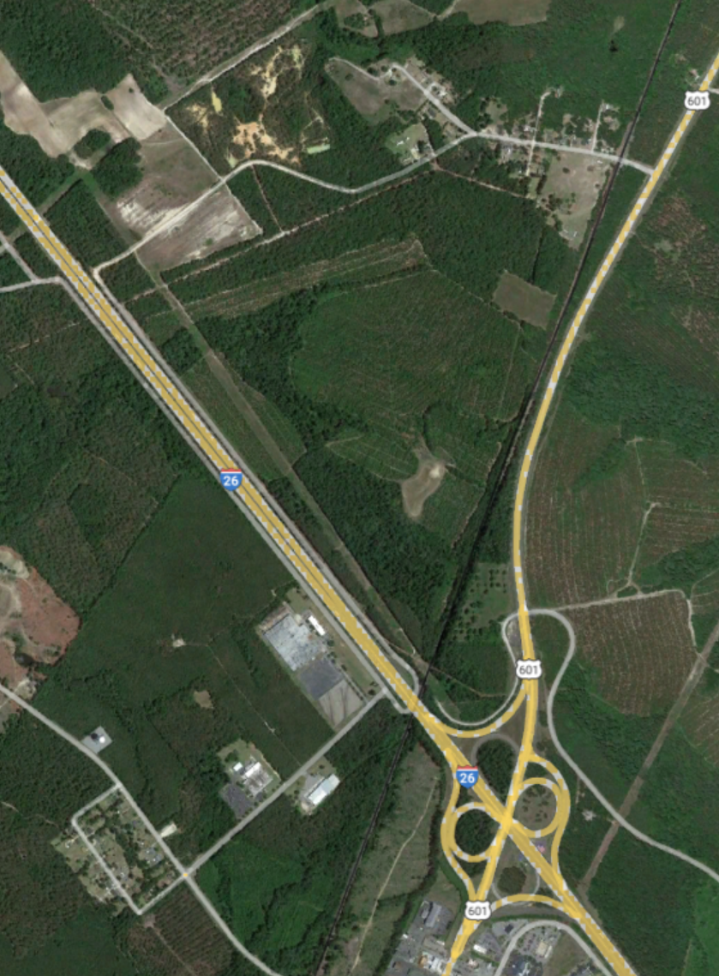
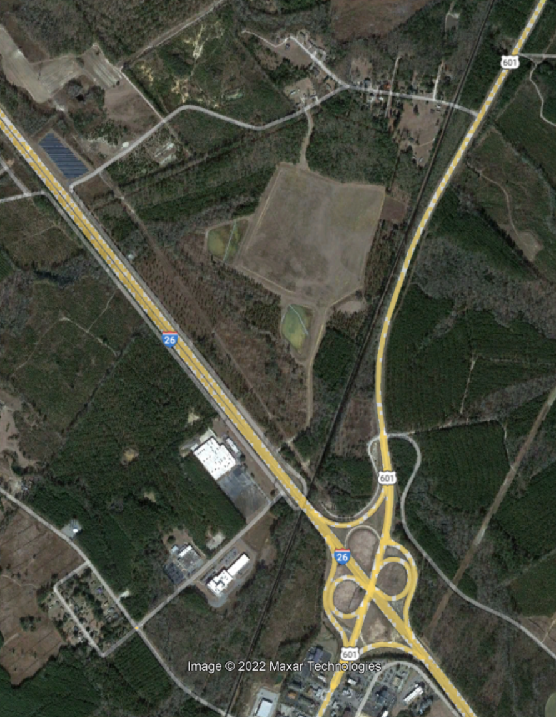
Digital Perception – Keeping up with Progress
Satellite imagery does not reflect progress made on padded and graded acreage.

Slide 23
Due Diligence Summary – Controlling the Narrative
DOCUMENTATION | STATUS / DATE COMPLETED | COMMENTS
Documentation of Control/Ownership | N/A | Property is owned by county – land price is listed at $25,000 an acre, but can be leveraged for prospect during incentive negotiations.
Phase I Environmental Site Assessment | June 23, 2019 | Phase I ESA was completed on 600 acres. One recognized environmental condition was identified. This was an above ground storage tank that has been removed. Letter from DHEC has been provided which indicates AST has been removed and no further investigation is not required.
Wetlands Delineation | April 23, 2020 | Wetlands delineation has been completed on 600 acres. Wetland areas run along the southern boundary and do not affect developable portions of property or road access.
Jurisdictional Determination letter from the U.S. Army Corps of Engineers | April 23, 2020 | Request for jurisdictional determination was submitted to the Corps, and their office concurred with findings of the wetlands delineation.
Threatened and Endangered Species Survey | October 14, 2022 | T&E Species survey conducted on 600 acres. Critical habitat for gopher tortoise were identified on-site. Mitigation plan is included that shows species can be relocated within 30 days and estimated cost is $35,000. Community is prepared to complete and fund this work for site development. We have previously done this for XYZ company which took 15 business days.
Archaeological and Historical Investigation | October 14, 2022 | Cultural investigation was completed on 600 acres. One site (AE3724723) was identified on the far NE corner of the property. This is a cemetery. A 50-foot buffer should be maintained, but will not impact the site layout dimensions provided by client.
Geotechnical Assessment | October 14, 2022 | Geotechnical Assessment was completed on the property – 25 borings were completed at depths of 20-30 feet. Partially weathered rock was encountered that is typical of the area. A site prep cost can be gathered for the proposed building dimensions upon request. Adjacent tenants did not encounter Geotech that was problematic.
Master Conceptual Plan | October 14, 2022 | Master Conceptual Plan provided as purely schematic of how we envision road access, lot division based on natural impediments, building site/dimensions – but these are conceptual and can be adjusted to your needs.
Boundary Survey | October 14, 2022 | Boundary survey provided that shows as-built utilities and rights-of-way to avoid during development.

Slide 24
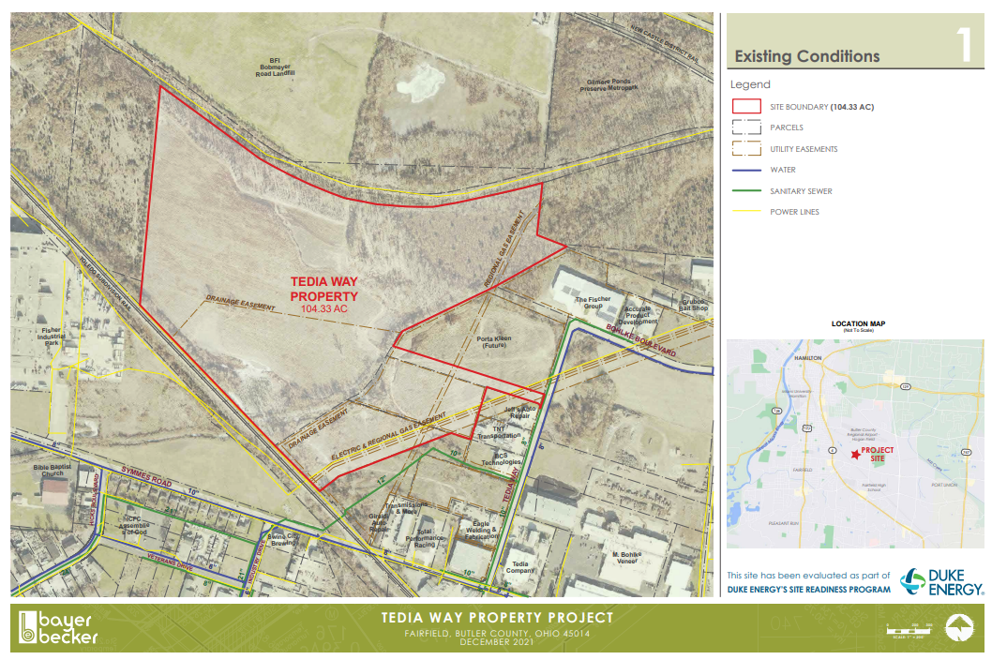
Example of Clean & Consistent Map Deck
Comments
We especially like how this map adds names of adjacent companies/users along with showing utility lines.
While it could get a little too “busy” this is an example where you could highlight key capacities in lines.

Slide 25
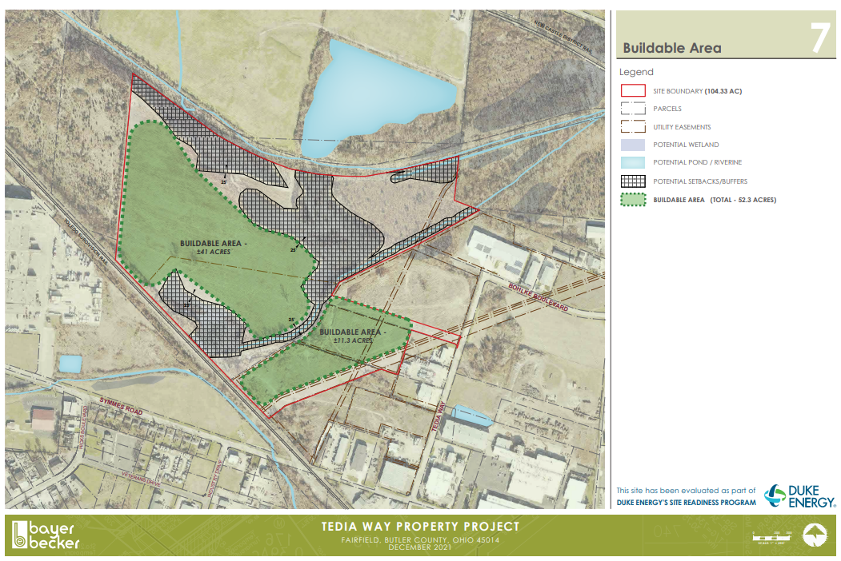
Example of Clean & Consistent Map Deck
Comments
SSG loves high quality buildable area maps! Not only does it show what’s realistic (e.g. we’ve seen a lot of 100 acre sites that have far less than 100 acres of buildable area), but it shows that the community/owner really understands what’s viable or not.

Slide 26
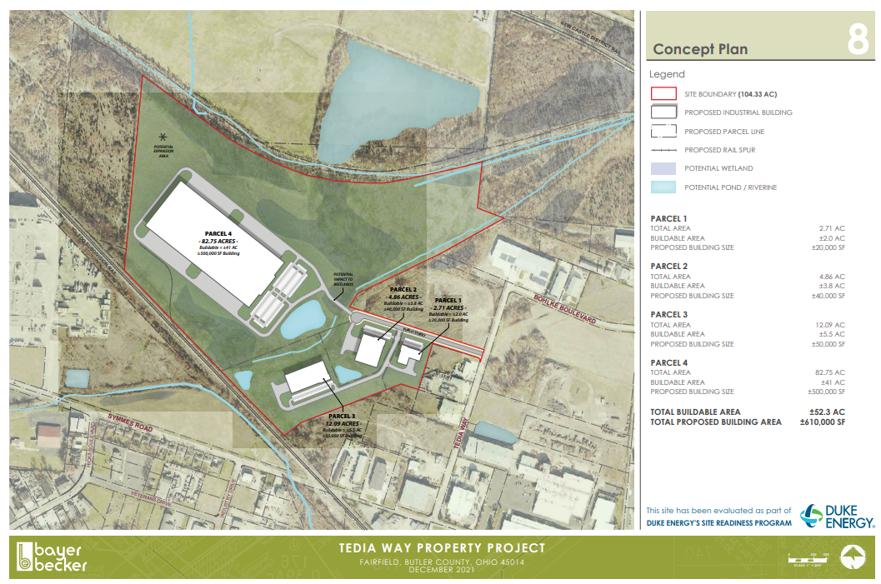
Example of Clean & Consistent Map Deck
Comments
A great example of a conceptual plan with a single large user complemented by a few smaller users.

Slide 27

8235 Douglas Avenue | Suite 500 | Dallas, TX 75225
siteselectiongroup.com

