Slide 1
A N AT O MY O F T HE DE A L :
Retail Development Case Studies

Slide 2
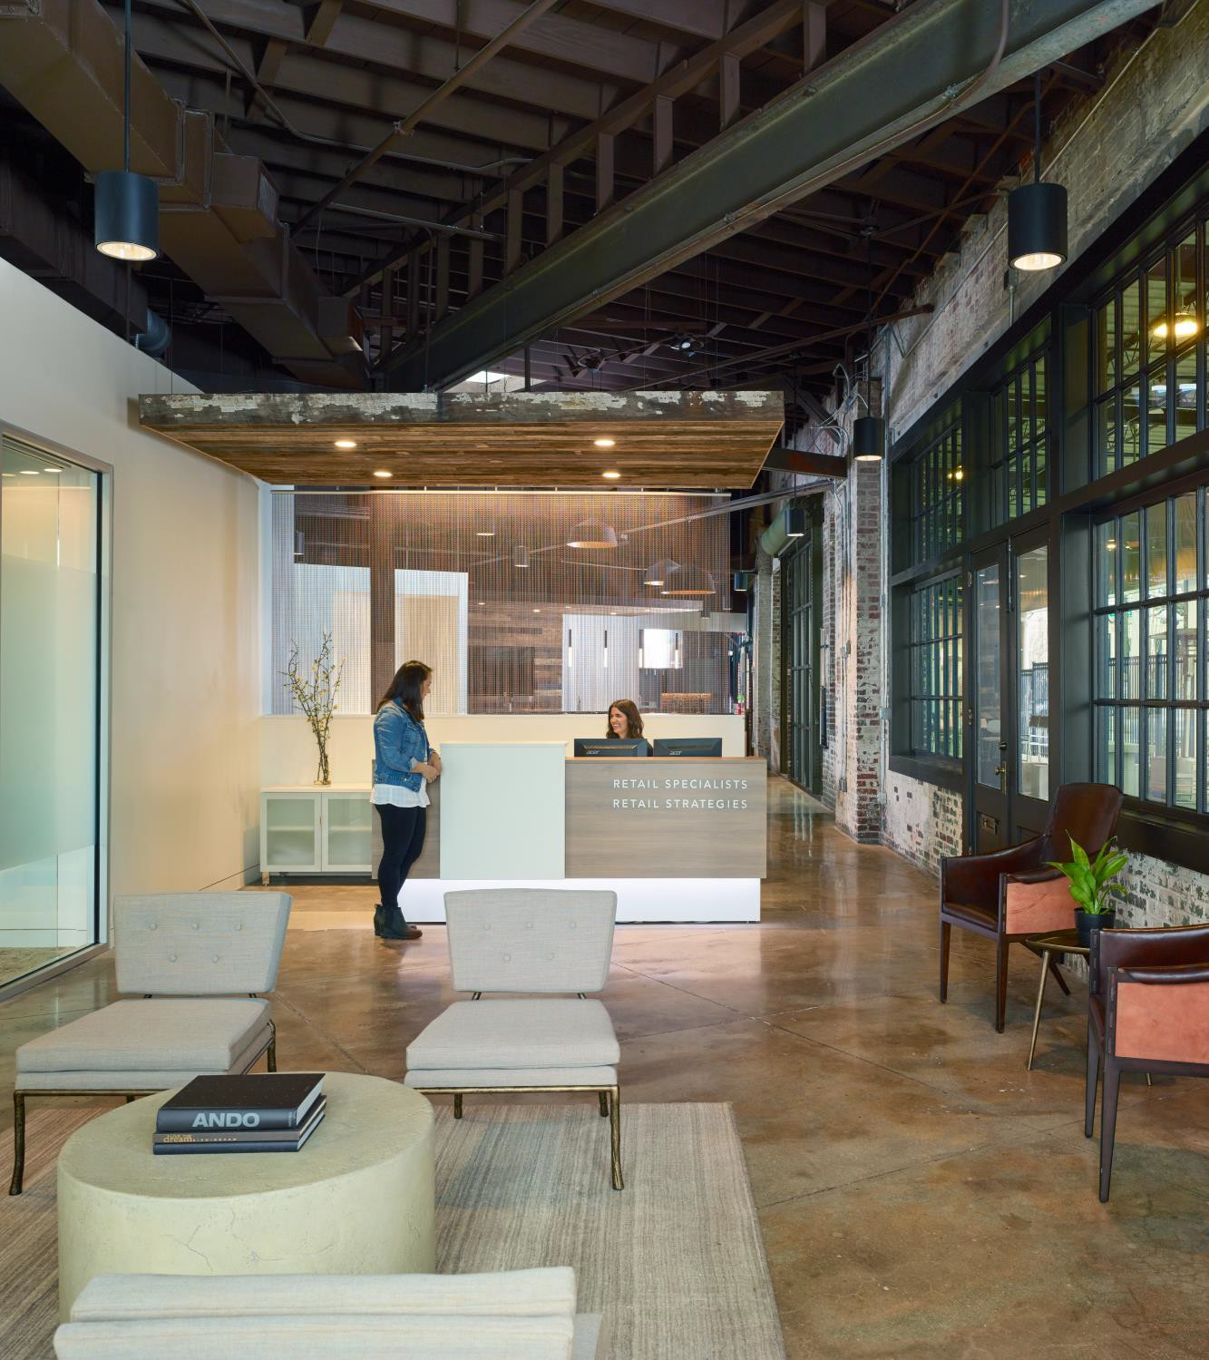
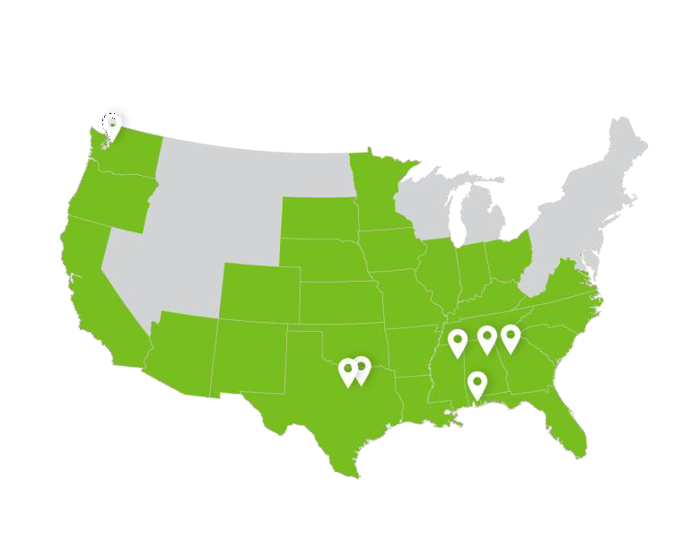
About Us
ONE COMPANY, SEVERAL SERVICES
Grown from a Commercial Real Estate firm, we focus on all facets of community growth, recruitment and retention. Our team of 70 utilizes experience to make public-private partnerships thrive.

Slide 3
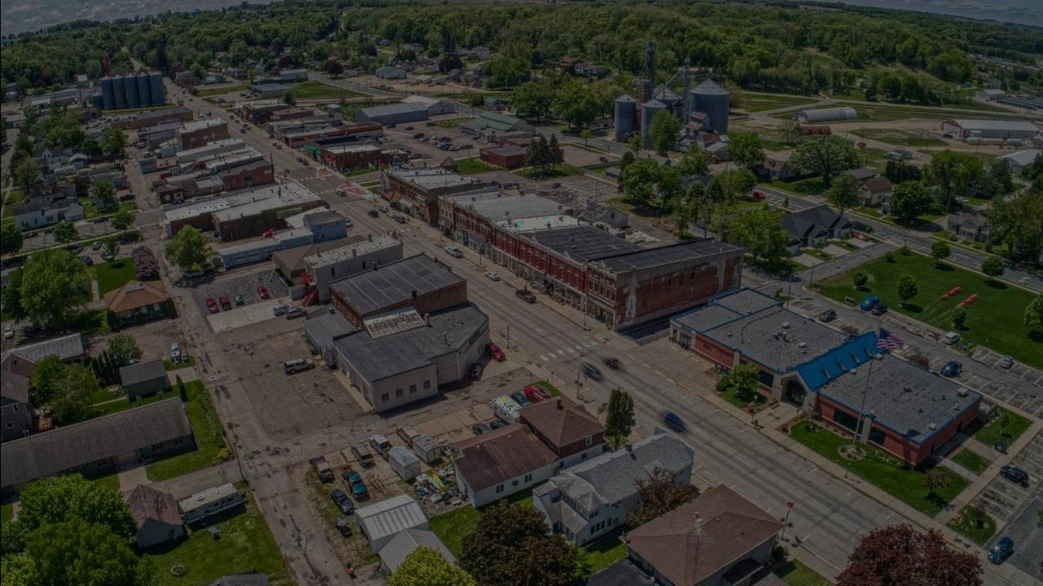
Kentucky Footprint
I M PA C T O N T H E S TAT E

Slide 4
Boyd County-Ashland, Kentucky
Key Facts
R e de f i n i n g r e ta i l m a r k e t po te n t i a l i n e a s te r n K e n tu c k y
B o y d C o u n ty : 4 6 , 9 5 1
C u s to m t r a d e a r e a : 9 8 , 4 2 6
C o m p e t i t i v e C h a l l e n g e : R e g i o n a l b o r d e r c o m m u n i ty , e c o n o m i c h e a d w i n d s
C o m p e t i t i v e A d v a n ta g e : R e g i o n a l h u b , l e a d e r s h i p , h u m a n e f fo r t

Slide 5
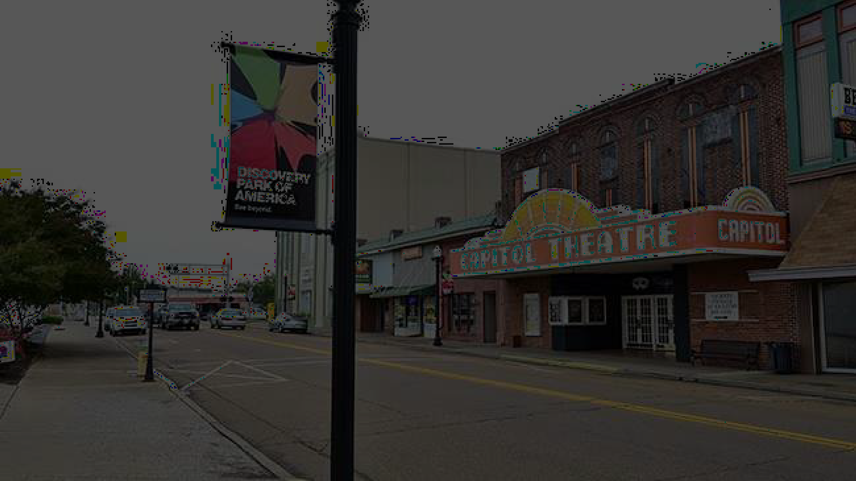
Union City, Tennessee
Key Facts
• | No r th w e s te r n T N bo r de r c o m m u n i ty - be s t fo o t fo r w a r d
• | O b i o n C o u n ty : 3 2 , 0 0 0 / U n i o n C i ty 1 0 , 1 6 0
• | C u s to m T r a d e A r e a : 6 5 , 2 1 0
• | C o m p e t i t i v e C h a l l e n g e : C o m p e t i n g r u r a l m a r k e ts , d e c l i n e i n
• | p o p u l a t i o n C o m p e t i t i v e A d v a n ta g e : T o u r i s m , l o g i s t i c s , l o c a l c o l l a b o r a t i o n

Slide 6
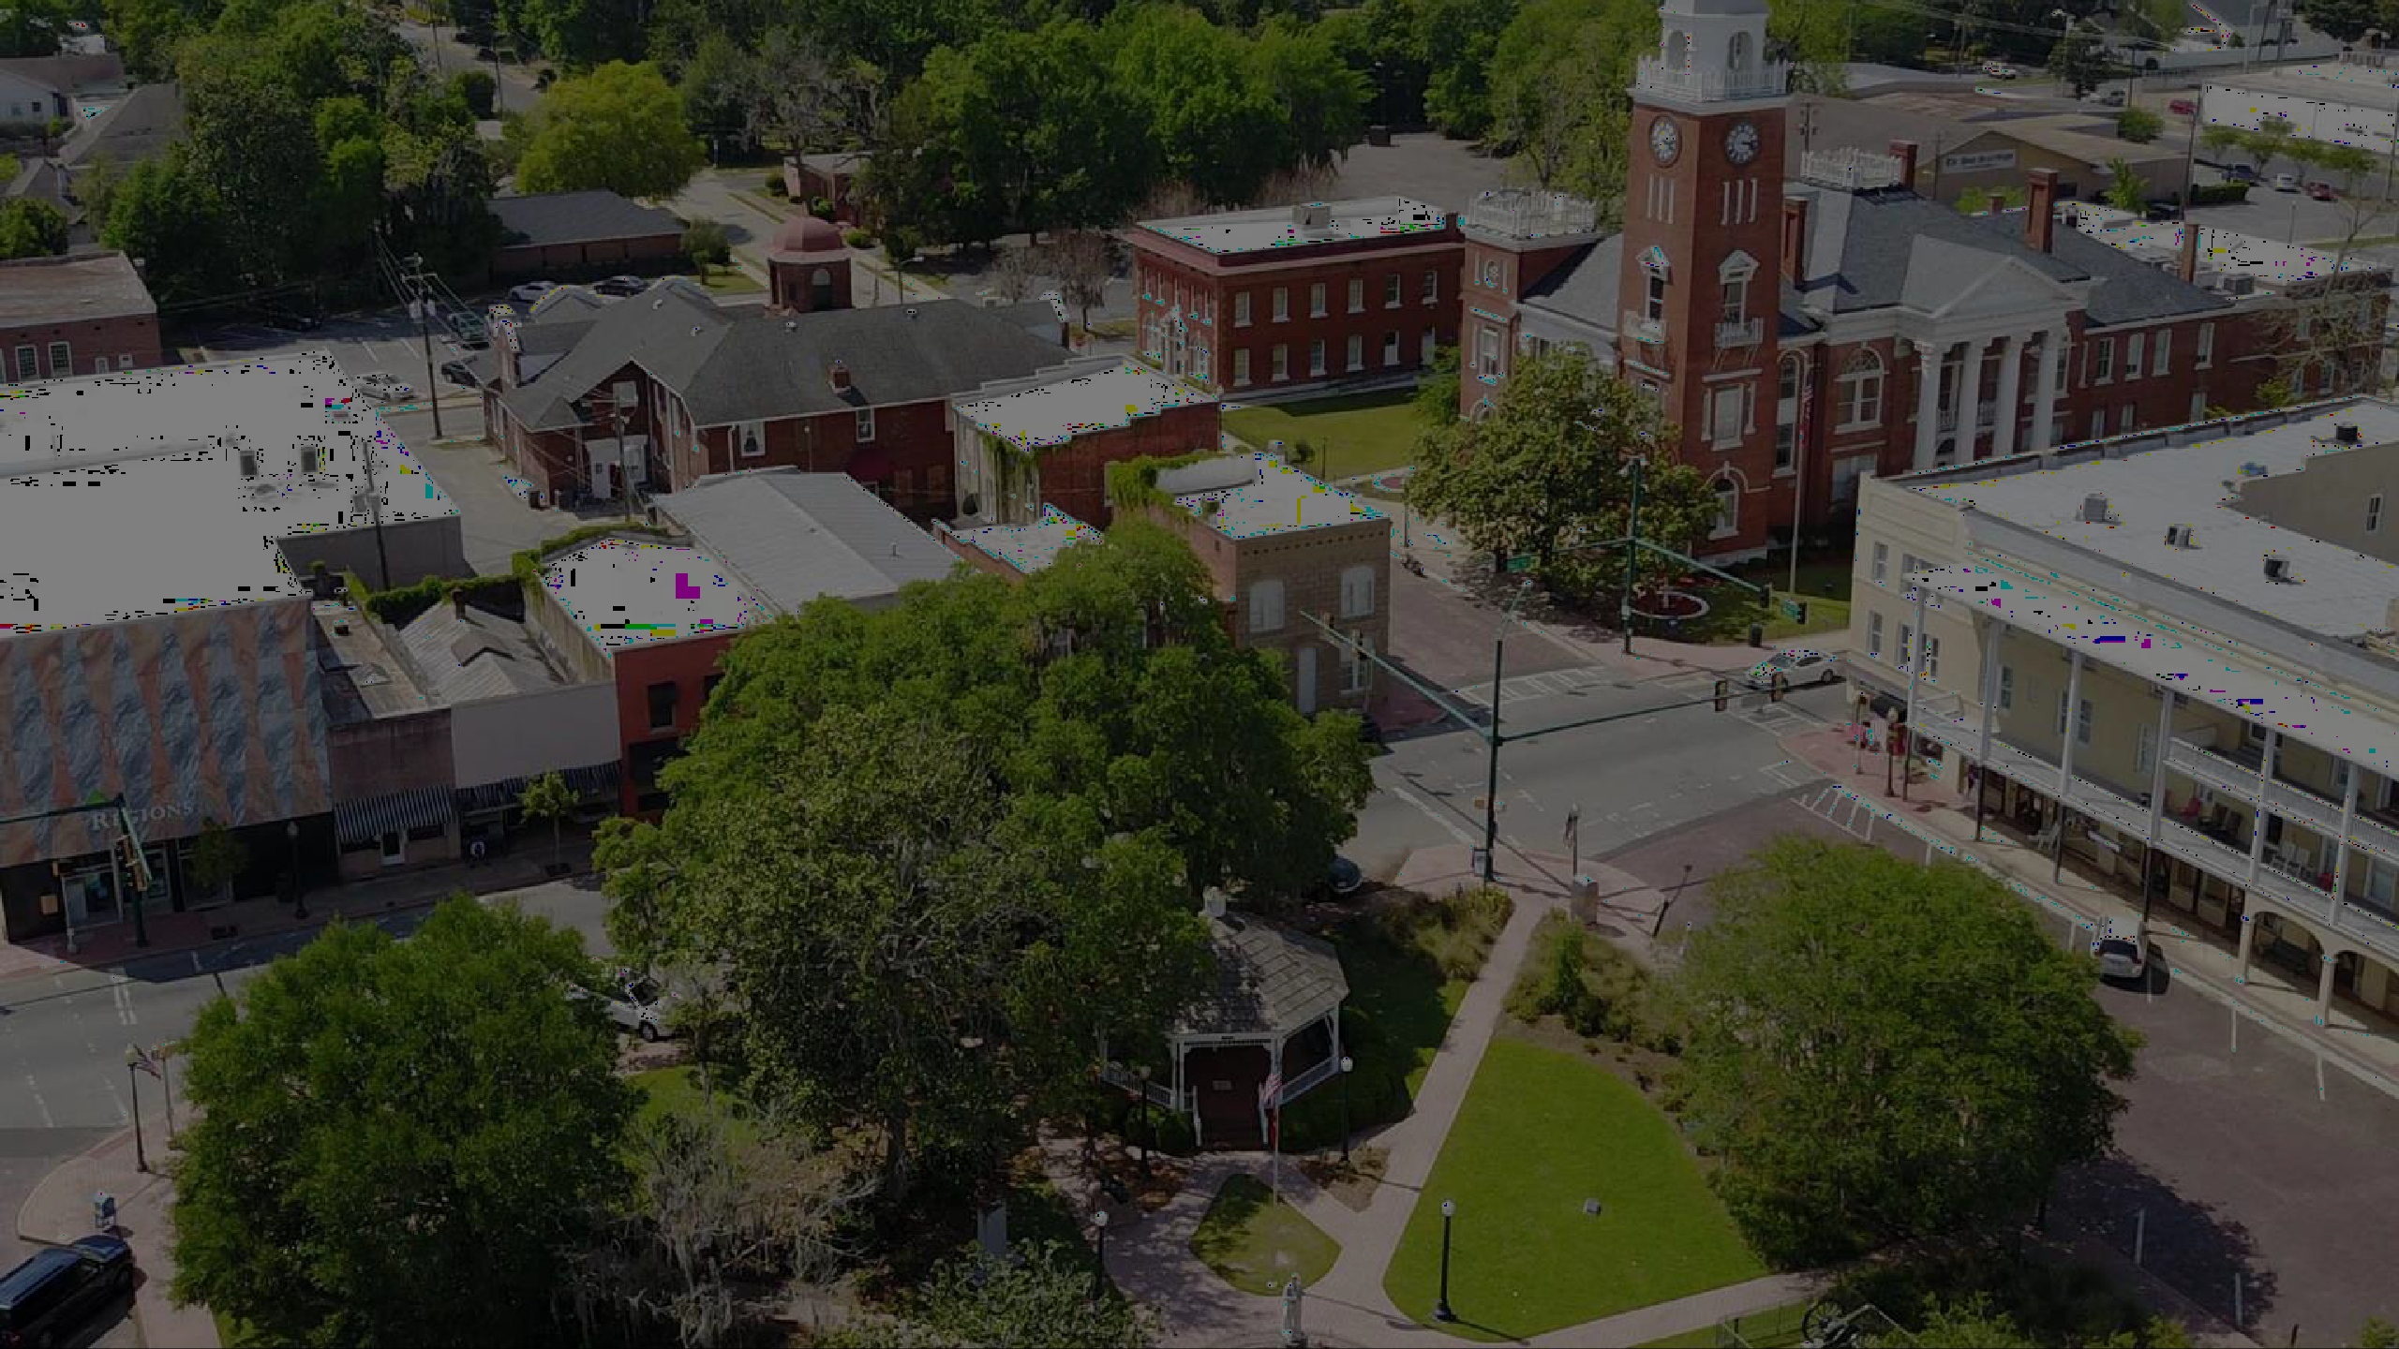
Bainbridge, Georgia
Key Facts
S o u th w e s t G e o r gi a - gr o w i n g c o m m u n i ty de s pi te r e gi o n a l
h e a d w i n d s
B a i n b r i d g e : 1 2 , 5 5 6
C u s to m T r a d e A r e a : 3 5 , 4 6 4
C o m p e t i t i v e C h a l l e n g e : L o c a t i o n , d e m o g r a p h i c a n d w o r k fo r c e h e a d w i n d s , l i m i te d A + r e ta i l s i te s
C o m p e t i t i v e A d v a n ta g e : P a r tn e r s h i p s , c a n d o m e n ta l i ty , p r o g r e s s i v e l e a d e r s h i p

Slide 7
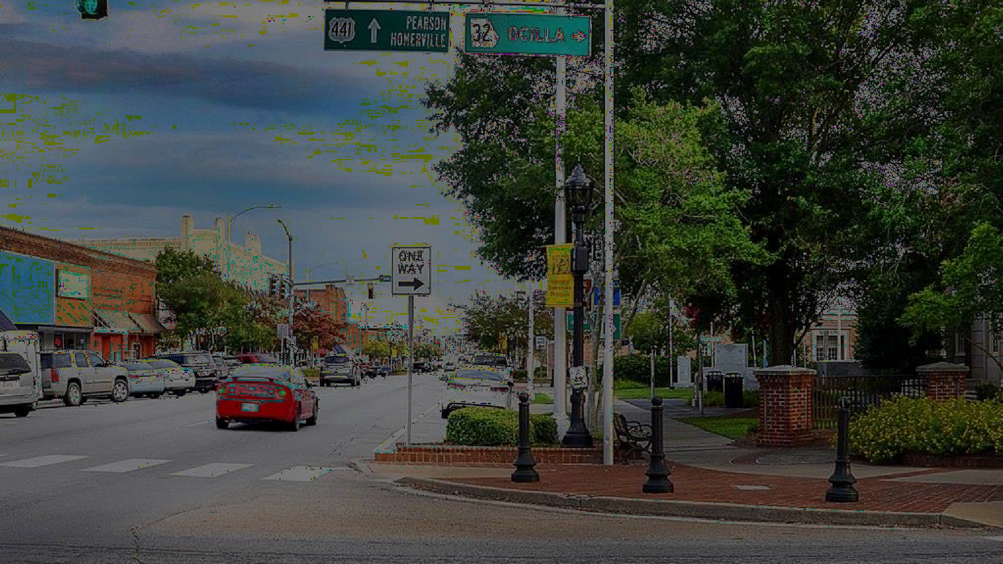
Douglas, Georgia
Key Facts
S o u th e a s t G e o r gi a - C o m m i t te d to a h o l i s t i c v i s i o n o f gr o w th
D o u g l a s - 1 1 , 6 5 7
C u s to m T r a d e A r e a : 6 2 , 6 1 9
C o m p e t i t i v e C h a l l e n g e s : g e o g r a p h i c l o c a t i o n , h o u s i n g , r e ta i l s u r p l u s
C o m p e t i t i v e A d v a n ta g e s : c i ty - c o n t r o l l e d p r o p e r ty , c o l l a b o r a t i v e l e a d e r s h i p

Slide 8
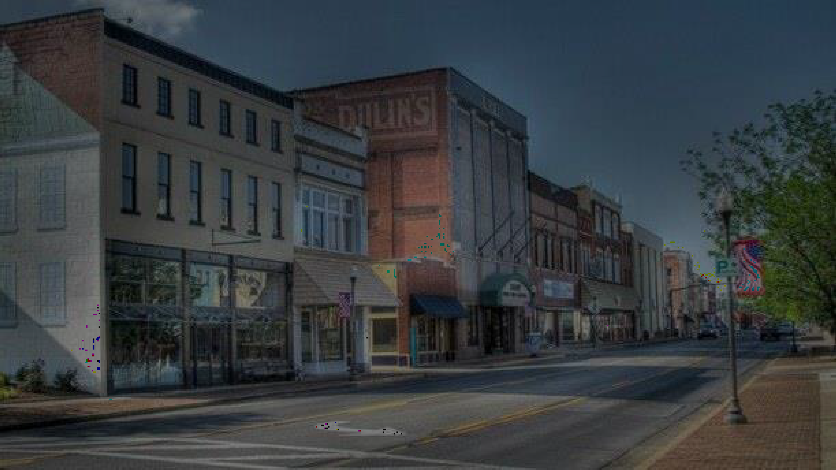
Madisonville-Hopkins County, Kentucky
Key Facts
W e s te r n K e n tu c k y – P r o j e c t D o m i n o
H o p k i n s C o u n ty : 4 6 , 1 5 3
C u s to m T r a d e A r e a : 6 1 , 5 5 5
C o m p e t i t i v e C h a l l e n g e s : R e ta i l p r o o f o f c o n c e p t , u n i q u e r e a l e s ta te a n d i n f r a s t r u c tu r e c h a l l e n g e s
C o m p e t i t i v e A d v a n ta g e s : P P P w i l l i n g n e s s , g r o w th m o m e n tu m , q u a l i ty o f l i fe i n i t i a t i v e / r e c r e a t i o n , i n te r s ta te a c c e s s

Slide 9
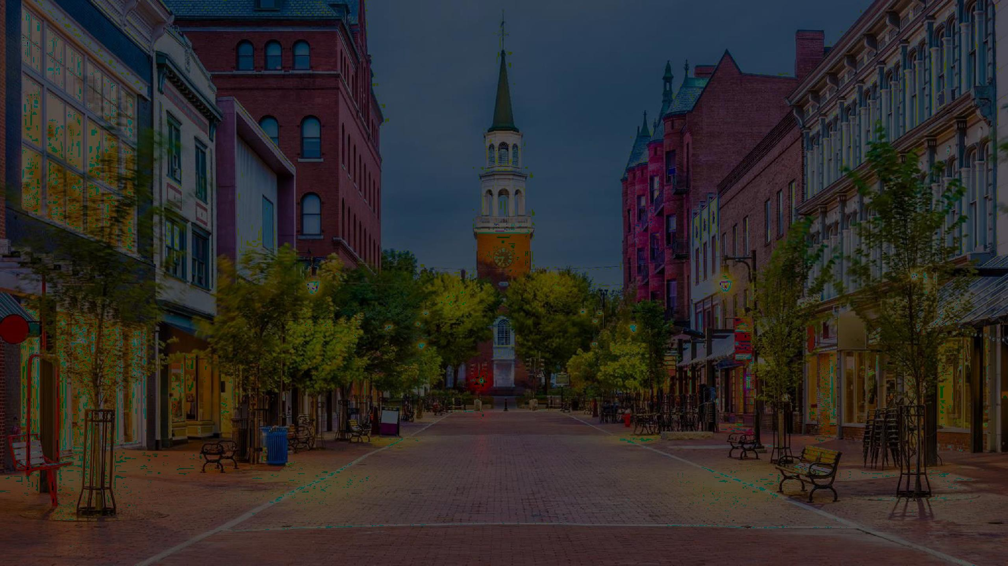
Defining Your Competitive Advantage

Slide 10
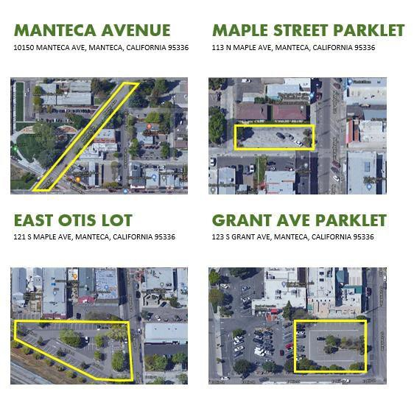
G ET C O M PET I T I V E
Take Inventory
Real Estate Assets
Community Resources:
Potential franchisees
Business owners
Investors
Property owners
Community Assets
Major employers
Hospitals, Universities

Slide 11
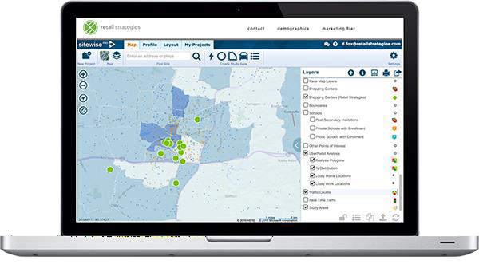
Data & Analytics
G ET C O M PET I T I V E
Define your community through data
GAP Analysis
Peer Analysis
Provide information that retailers don’t
have
Let data drive your story telling

Slide 12
G ET C O M PET I T I VE
Targeted Prospects
 | Site Criteria
Category: | Food & Beverage
Demographic Radius Ring Requirement: | 3
Minimum Population Requirement: | 9,000
Household Income Requirement | $65,000
Traffic Count | 20,000 VPD
Number of SF or AC: | 1,100 SF
Location Comments: | Standard “Vanilla” shell with improvements. Morning side of roadway, drive-thru window preferred. Free standing, shared pad, or end cap located in mix use “major tenant” community shopping center with national or regional tenant.
Create a Plan
Align your vision with city council’s
plan
Proximity First
Prospect retail and restaurant that are
in nearby markets
Think regional
Understand Site Criteria for Prospects
Be Realistic

Slide 13
G E T C O M P E T I T I V E
Development Timelines
What can the city control? Where can you improve?
Get Competitive with your Timeline vs Surrounding Communities
Automation vs Human Effort

Slide 14
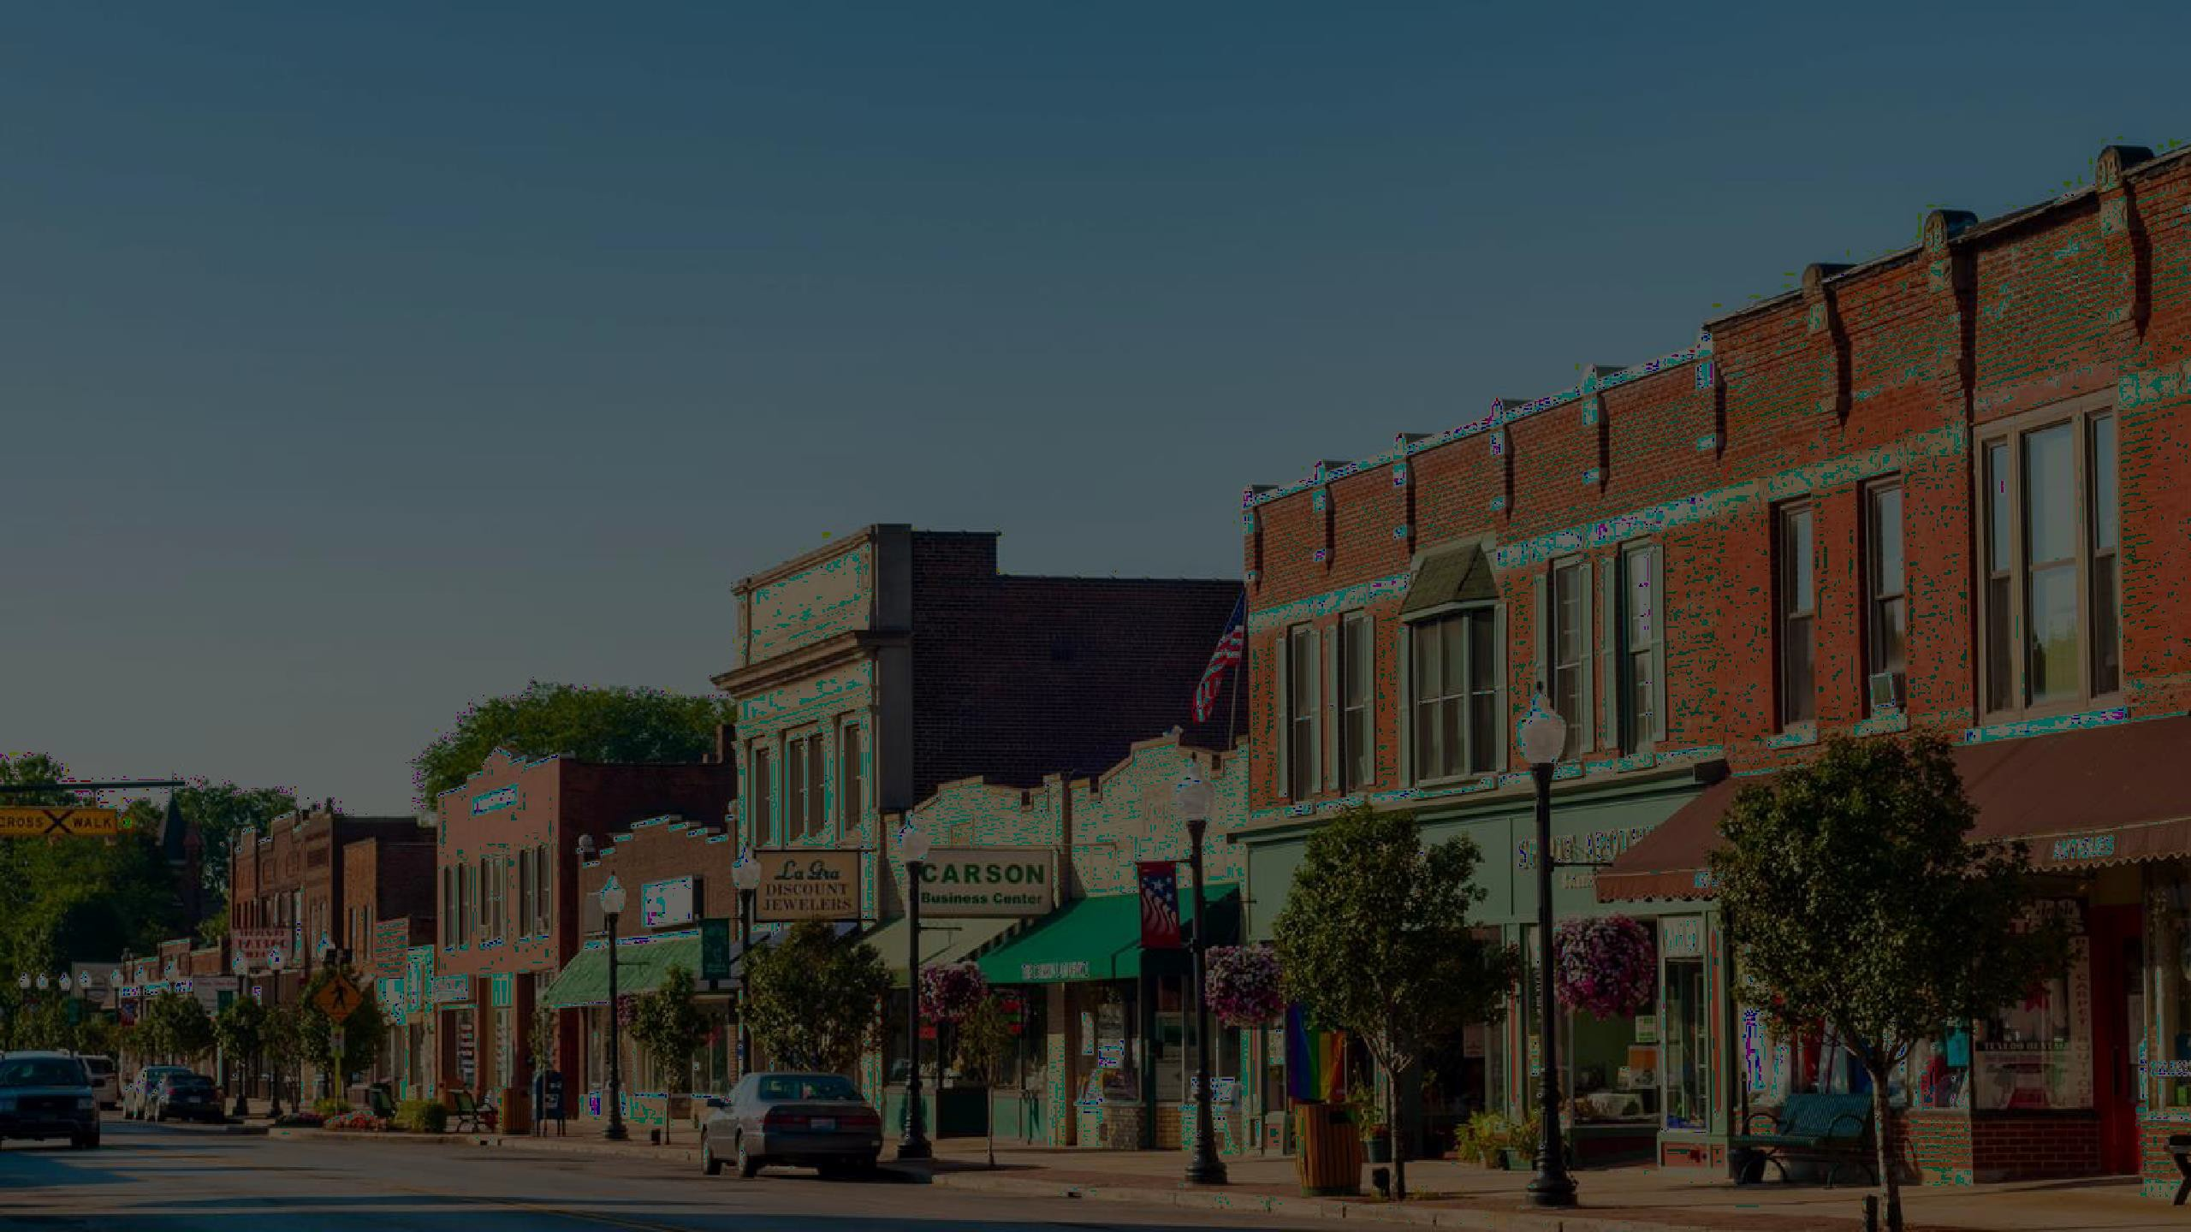
Keep Going
G ET C O M PET I T I V E
Don’t get discouraged by NO – Learn from it!
Doing nothing is doing something
Look for cracks that give you a chance to tell your story

Slide 15
Contact Us
Mill Graves
mill@retailstrategies.com

