Slide 1
Competency Based Education
Alignment of Education, Workforce, and Economic Development for Northeast Kentucky

Slide 2
What is CBE? …and why now?
Tick…….Tick…… Tick…..

Slide 3
Time versus Competency
Bachelor’s Degree Four Years (Five for me!)
Associates Degree Two Years
Certificates/Certifications Short Term- Two Years
Needs of employees and employers

Slide 4
Historical Model of Education
Early Education Not Required Wealthier Population Religion-based
19th Century State Sponsored Education
20th Century Pubic Schools Progressive Education Movement
Modern Technology based economy
Still based on time! K-12, Higher Education

Slide 5
Economics of northeast Kentucky today
Northeast Kentucky Kentucky United States
Per Capita Income $22,353 $27,976 $34,136
Median Household Income $41,006 $50,617 $62,204
Average Household Income $56,889 $70,264 $90,005
Labor Force Participation 46.08% 56.00% 61.70%
(Boyette, 2021)

Slide 6
Workforce and jobs in northeast Kentucky
TENCO Workforce Investment Board has 19 pages with an average of 40 jobs per page of open job listings in the Ashland area (That’s 740 jobs!).
Unemployment Rate August 2022
Boyd County KY 5.60%
Greenup County 5.90%
Carter County 7.90%
Kentucky 3.80%
United States 3.50%

Slide 7
Not just jobs, but highly-skilled careers!
Health Care Professional Nurses, Clinical Manager
Environmental Technicians Accountant
Lawyers/Law Clerks Sr. Go Kart Mechanic
Dental Hygienist Millwright
CDL Welder
Pharmacy Technician Machine Operator
Automotive Social Worker
Maintenance Tech Electrician

Slide 8
Competency-Based Education
Time needed to demonstrate skills/competency
Intentional and transparent approach to curricular design
Aligns with the changing and dynamic/demanding needs of workforce
Meets the shortened nature of job-specific skill
Provides flexible delivery methods
KCTCS, 2022

Slide 9
CBE is A Movement…….
3,127 colleges and universities have at least some elements of CBE (2020 data)
76% of colleges believe CBE will grow in the next 5 years
60% of community colleges have CBE programs in development
28% of the 3,127 institutions with a CBE program are public 2-year institutions
-2020 National Survey of Postsecondary Competency Based Education (NPSCBE)

Slide 10
Why here? Why now? Why me?
Northeast Kentucky has helped build the Commonwealth, the nation, and the world
Education and training are the change lives for individuals and families
Investing in our people and aligning our assets is our greatest opportunity for a new future for our people

Slide 11
Economic Development is, in the simplest form, finding your competitive advantages and marketing to the world/community
It is about our people, their talents, dreams, and pathway to the future
Investing in our people, Aligning the needs to the opportunity
Compentency is the currency of tomorrow………Today

Slide 12
What does CBE look like?

Slide 13
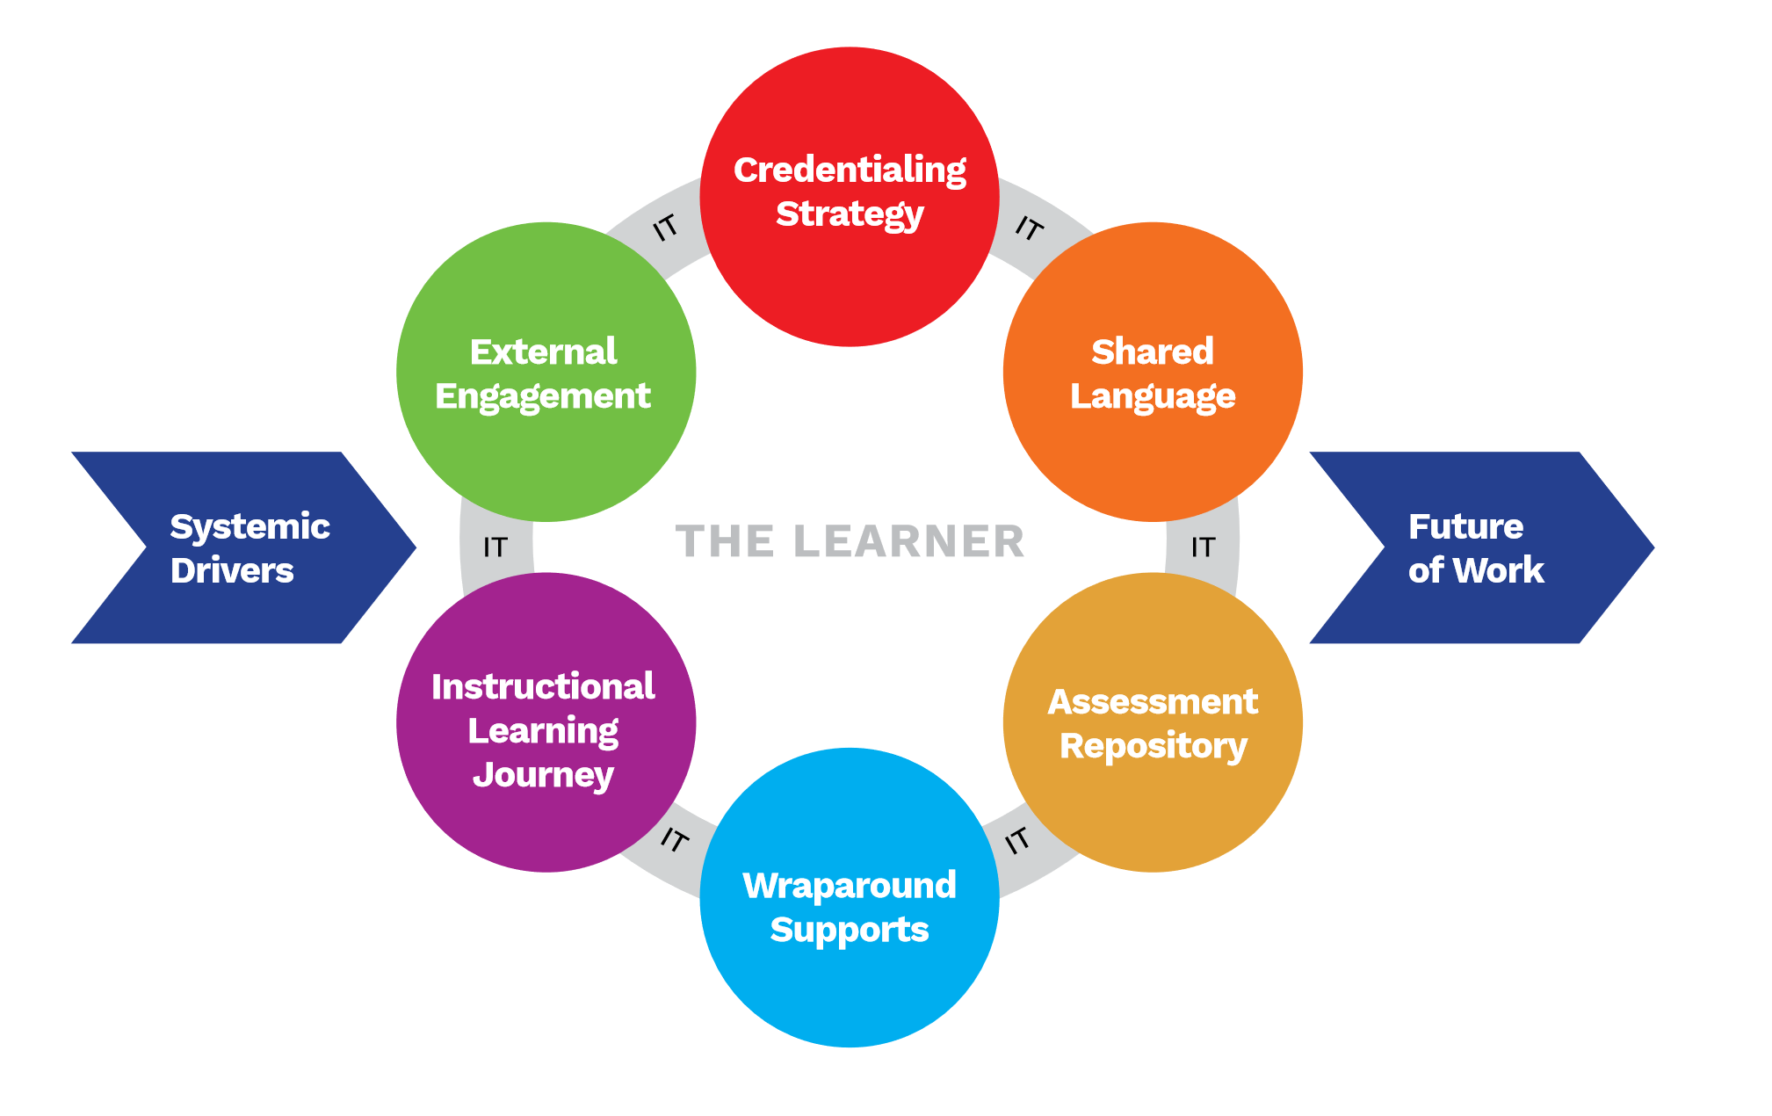
-Learner Focused -Flexible Delivery -On Time

Slide 14
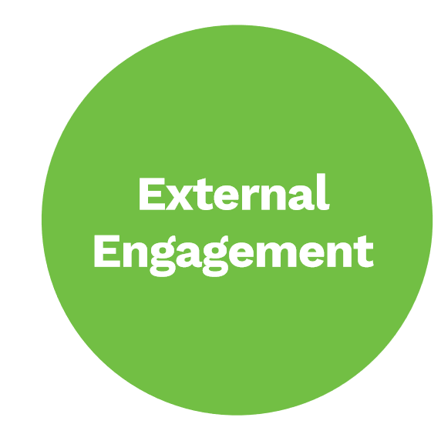
How this CAN Work! A little revolution every once in a while is a good thing!

Slide 15
Alignment of Education, Workforce, and Economic Development
Single most important slide, theme, idea presented today!
People are not LOOKING FOR JOBS.
They ARE LOOKING FOR Careers

Slide 16
How we all win!
CBE Aligns People to the workforce, which is aligned to the private sector and is supported by education and training.
Every Job is the start of a Career when we provide a seamless pathway to success

Slide 17
What is New is Old!
CBE history traces back to the 1970s
For Profit Education embraced over the last 20 years
Google defines Competency from Latin Competenia, meaning Together, Agreement, Symmetry
It is about having skill, confidence which can be justified, and sufficiency for qualification.

Slide 18
Lincoln is the Man!
Abraham Lincoln Practiced Law for 25 years
He borrowed his first law book and was self-taught
He practiced law in front of Eight Judicial Court in Illinois and was renowned for his technical skills
There was never a question of his skills or knowledge
Lincoln, Law, 2022

Slide 19
Benjamin Franklin…..always ahead of his time!
Benjamin Franklin was a prolific serial inventor
Franklin was an early proponent of CBE
The pace of advancement in technology dictates that we move as fast as the industry
Lessons learned and applied from the workplace will build the nation
Media, n.d

Slide 20
My analysis of the research on the workforce from the defined area of northeast Kentucky has provided clear findings for the need for additional pathways for worker participation and advancement, even with the need for further research.

Slide 21
Our Path Forward
Our future uses our economic drivers to create a net competitive advantage in workforce and training. Research has shown that community colleges can be drivers of economic development. This competitive advantage is building on the triad of adult higher education, workforce development, and economic development and capturing the talent and experience of the existing workforce with an individual pathway for personal growth. CBE is a process of the continuous evolution of the investment in ourselves.
-Nickoli, 2013

Slide 22
We will Win! We Win Together!
Lincoln, Franklin, Dr. Ferguson, and the Commonwealth got it right.
United we stand. Divided we fall. We are Kentucky.

