Slide 1
Supply Chain Management
in Kentucky
KIED IS ACCREDITED BY THE IEDC

Slide 2
TODAY’S OUTLINE
Personal Introduction
Supply Chain Management
Supply Chain in Kentucky
Q&A
KIED IS ACCREDITED BY THE IEDC

Slide 3
PERSONAL INTRO
University of Kentucky
Political Science, 1-year MBA
NPD, Supply Chain, M&A
Gatton MBA Board of Advisors
LeanCor Supply Chain Group (2007-2014)
Logistics Engineering
Route Management
Operations and Strategy
KIED IS ACCREDITED BY THE IEDC

Slide 4
PERSONAL INTRO (cont.)
NovIntu Software Solutions (2014 - ???)
Custom Development
The Lean Office
Dowdy Crop Innovations
Gatton MBA (2016-present)
Adjunct Professor, Supply Chain
KIED IS ACCREDITED BY THE IEDC

Slide 5
PERSONAL INTRO (cont.)
Siever Family (est. 2004)
Camilya
Clay
Zack
Rose
KIED IS ACCREDITED BY THE IEDC

Slide 6
SUPPLY CHAINS IN THE NEWS
KIED IS ACCREDITED BY THE IEDC

Slide 7
SUPPLY CHAIN MANAGEMENT
Definition
Sample Network
Systems Thinking
Why Study Supply Chain?
“You will not find it difficult to prove that battles, campaigns, and even wars have been won or lost primarily because of logistics.”
-President (and General) Dwight D. Eisenhower
KIED IS ACCREDITED BY THE IEDC

Slide 8
DEFINING SUPPLY CHAIN MANAGEMENT
Supply Chain Management ≠ Logistics
AKA . . .
Demand Chain
Performance Chain
Fulfillment Stream
Value Chain
Value Stream
Logistics
Supply Chain
KIED IS ACCREDITED BY THE IEDC

Slide 9
DEFINING SUPPLY CHAIN MANAGEMENT
How do you define Supply Chain Management?
KIED IS ACCREDITED BY THE IEDC

Slide 10
DEFINING SUPPLY CHAIN MANAGEMENT
“Supply chain management encompasses the planning and management of all activities involved in sourcing and procurement, conversion, and all logistics management activities. Importantly, it also includes coordination and collaboration with channel partners, which can be suppliers, intermediaries, third party service providers, and customers. In essence, supply chain management integrates supply and demand management within and across companies.”
-CSCMP (Council of Supply Chain Management Professionals)
KIED IS ACCREDITED BY THE IEDC

Slide 11
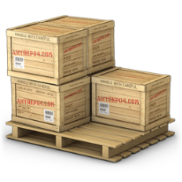
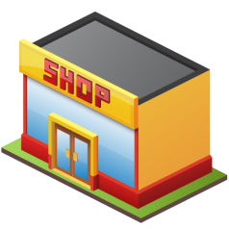
SUPPLY CHAIN DEFINITIONS
Critical Elements
Product / Service
Customer
Relationships (Network)
Information
System
KIED IS ACCREDITED BY THE IEDC
Supply Chain Management

Slide 12
SAMPLE NETWORKS
What type of firm has this type of network?
?
KIED IS ACCREDITED BY THE IEDC

Slide 13
SAMPLE NETWORKS
What type of firm has this type of network?
?
KIED IS ACCREDITED BY THE IEDC

Slide 14
SAMPLE NETWORKS
What type of firm has this type of network?
?
KIED IS ACCREDITED BY THE IEDC

Slide 15
SYSTEMS THINKING IN SUPPLY CHAIN
What is a system?
External systems
Internal systems
Strategy (30k foot view)
“A bad system will beat a good person every time.”
-W. Edwards Deming
KIED IS ACCREDITED BY THE IEDC

Slide 16
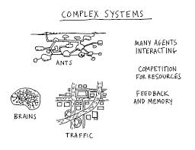
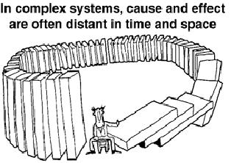
SYSTEMS THINKING IN SUPPLY CHAIN
What is a system?
a set of connected things or parts forming a complex whole
KIED IS ACCREDITED BY THE IEDC
Notes:
Think of the body as a system – different functions, completely interrrelated

Slide 17
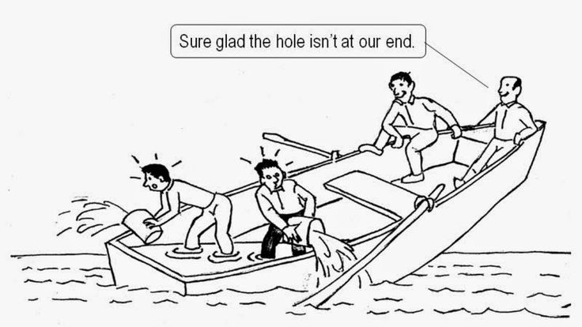
SYSTEMS THINKING IN SUPPLY CHAIN
External systems
“The result of long-term relationships is better and better quality, and lower and lower costs.” -W. Edwards Deming
KIED IS ACCREDITED BY THE IEDC
Notes:
Watched this happen many times – supplier would fail, customer would walk away (or continue penalizing)
GM supplier (<300 employees) almost shut down 19 plants in July

Slide 18
SYSTEMS THINKING IN SUPPLY CHAIN
Internal systems
METRICS
Quality, Cost, Delivery
KIED IS ACCREDITED BY THE IEDC
Notes:
Balancing act – if you manage to one metric, others will suffer-must have a “systems” mindset
Can’t incentivize departments against each other
Logistics – transportation cost; Sales – customer fill rate

Slide 19
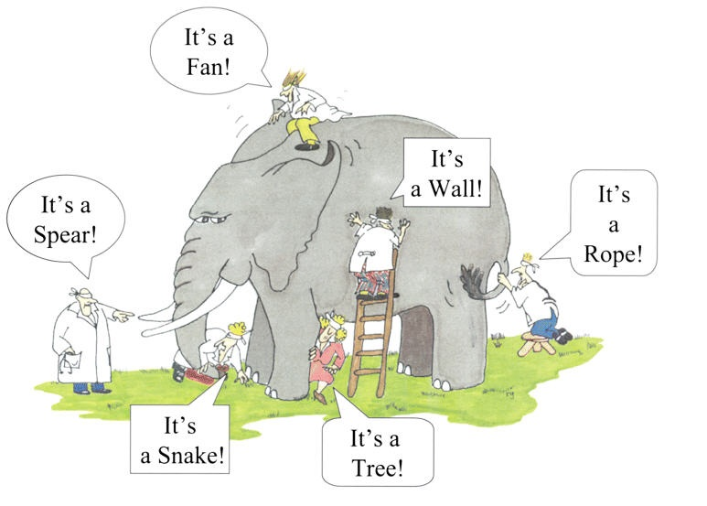
SYSTEMS THINKING IN SUPPLY CHAIN
Strategic Thinking
KIED IS ACCREDITED BY THE IEDC

Slide 20
WHY STUDY SUPPLY CHAIN?
Income Statement
Revenue
Cost
SG&A
Balance Sheet
Inventory Days
Accounts Receivable & Payable
Statement of Cash Flows
-Supply Chain Management Review (SCMR)
Financial Statements
KIED IS ACCREDITED BY THE IEDC
Notes:
Revenue (Lead time, new product launch, on-time delivery, product quality and returns, fill rates)
Cost (Transportation, procurement, inventory, packaging, etc.)
Sales, General & Administrative ((Warranty, selling, transaction accuracy)
Inventory Days – Inventory Carrying Costs, obsolescence, forecast accuracy, sourcing and delivery time
A/R and A/P – Relationships with suppliers and customers, invoice terms, invoice accuracy
SCF – Measures cash cycle, impacted entirely by supply chain

Slide 21
WHY STUDY SUPPLY CHAIN?
Shift from cost center to source of competitive advantage
“One study shows that those top-quartile performers are spending just 4.2% of revenue on supply-chain costs compared to almost 10% for average performers in the same industry. If all companies managed their supply chains as well as their best competitors, they would aggregate hundreds of billions of dollars of value for their shareholders.” – Bain & Co.
Speed
Cost
Quality
“The classic model of company vs. company is starting to give way to a new model: supply chain vs. supply chain.”
-David Taylor
KIED IS ACCREDITED BY THE IEDC

Slide 22
SUPPLY CHAIN IN KENTUCKY

Slide 23
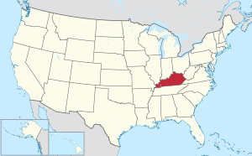
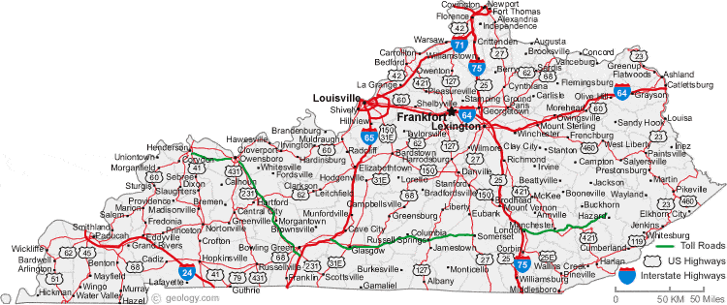
WHY IS SUPPLY CHAIN IMPORTANT IN KENTUCKY?
(These are hints….)
KIED IS ACCREDITED BY THE IEDC
Notes:
Revenue (Lead time, new product launch, on-time delivery, product quality and returns, fill rates)
Cost (Transportation, procurement, inventory, packaging, etc.)
Sales, General & Administrative ((Warranty, selling, transaction accuracy)
Inventory Days – Inventory Carrying Costs, obsolescence, forecast accuracy, sourcing and delivery time
A/R and A/P – Relationships with suppliers and customers, invoice terms, invoice accuracy
SCF – Measures cash cycle, impacted entirely by supply chain

Slide 24
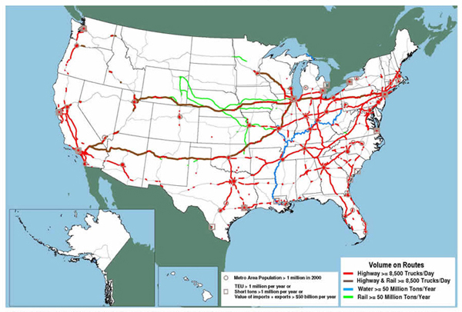
REASON #1 – FREIGHT TRAFFIC
KIED IS ACCREDITED BY THE IEDC
US Department of Transportation
Notes:
Revenue (Lead time, new product launch, on-time delivery, product quality and returns, fill rates)
Cost (Transportation, procurement, inventory, packaging, etc.)
Sales, General & Administrative ((Warranty, selling, transaction accuracy)
Inventory Days – Inventory Carrying Costs, obsolescence, forecast accuracy, sourcing and delivery time
A/R and A/P – Relationships with suppliers and customers, invoice terms, invoice accuracy
SCF – Measures cash cycle, impacted entirely by supply chain

Slide 25
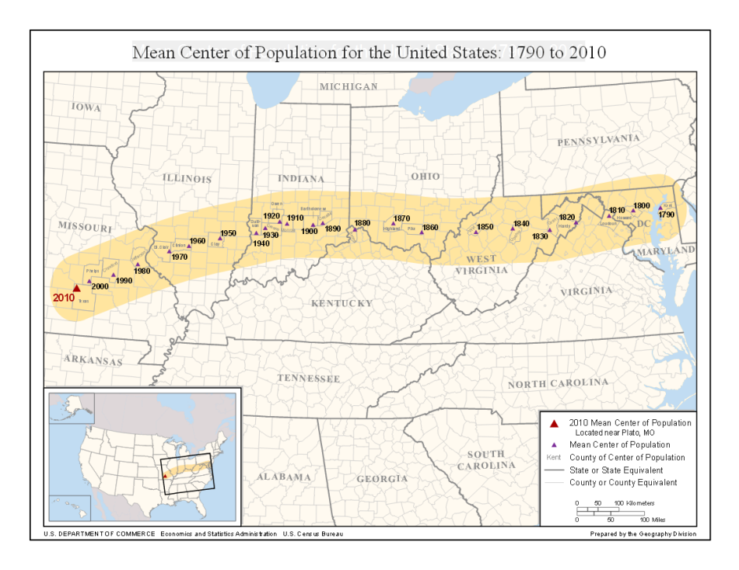
REASON #2 – US POPULATION
What is a “centroid”?
Where is the centroid of the United States?
KIED IS ACCREDITED BY THE IEDC
US Department of Transportation
Notes:
Revenue (Lead time, new product launch, on-time delivery, product quality and returns, fill rates)
Cost (Transportation, procurement, inventory, packaging, etc.)
Sales, General & Administrative ((Warranty, selling, transaction accuracy)
Inventory Days – Inventory Carrying Costs, obsolescence, forecast accuracy, sourcing and delivery time
A/R and A/P – Relationships with suppliers and customers, invoice terms, invoice accuracy
SCF – Measures cash cycle, impacted entirely by supply chain

Slide 26
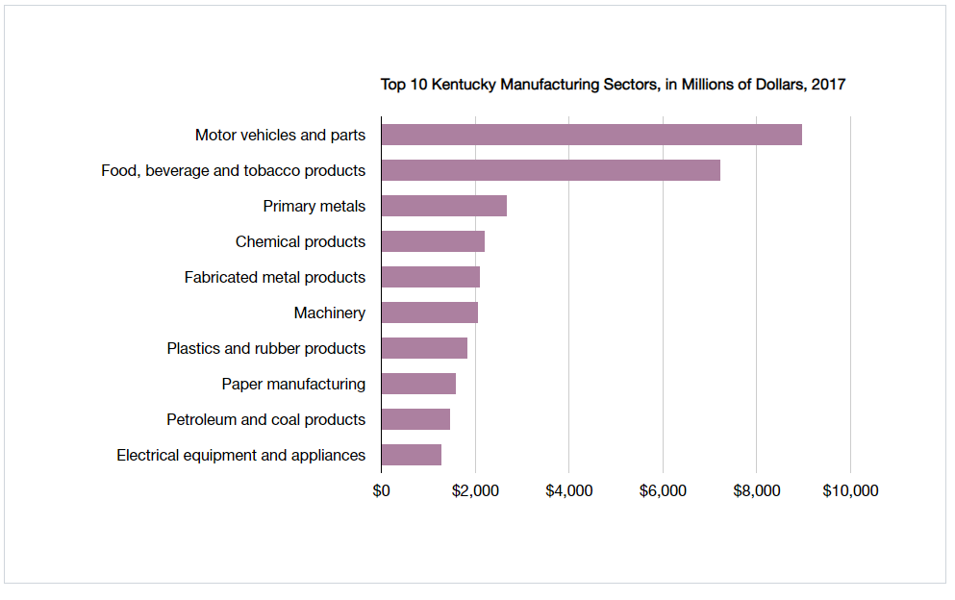
REASON #3 – MANUFACTURING
“Manufacturers in Kentucky account for 18.56% of the total output in the state, employing 13.07% of the workforce. Total output from manufacturing was $38.67 billion in 2018. In addition, there were an average of 255,000 manufacturing employees in Kentucky in 2019, with an average annual compensation of $72,614.25 in 2018.”
-National Association of Manufacturers. 2020 Summary
https://www.nam.org/state-manufacturing-data/2020-kentucky-manufacturing-facts/
KIED IS ACCREDITED BY THE IEDC
Notes:
Revenue (Lead time, new product launch, on-time delivery, product quality and returns, fill rates)
Cost (Transportation, procurement, inventory, packaging, etc.)
Sales, General & Administrative ((Warranty, selling, transaction accuracy)
Inventory Days – Inventory Carrying Costs, obsolescence, forecast accuracy, sourcing and delivery time
A/R and A/P – Relationships with suppliers and customers, invoice terms, invoice accuracy
SCF – Measures cash cycle, impacted entirely by supply chain

Slide 27
WHERE ARE OUR STRENGTHS?
Distribution
Consumption (28th in Total GDP)
Raw Material
(Farming, Natural Resources)
Manufacturing (8th per capita according to BLS)
KIED IS ACCREDITED BY THE IEDC

Slide 28
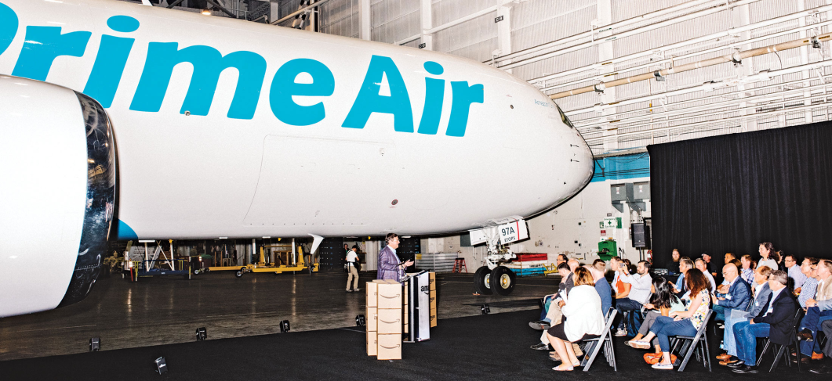
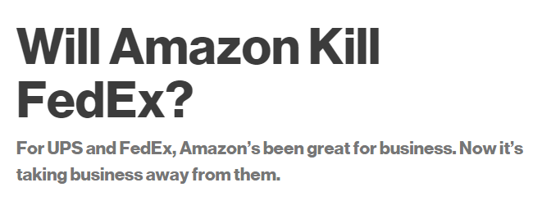
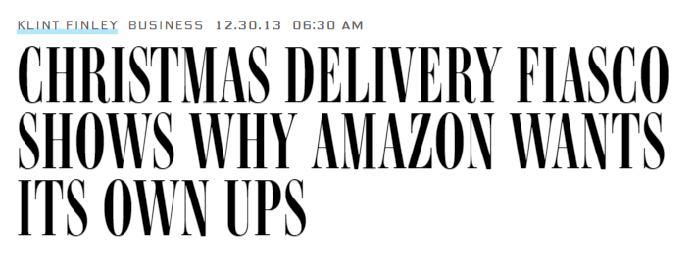
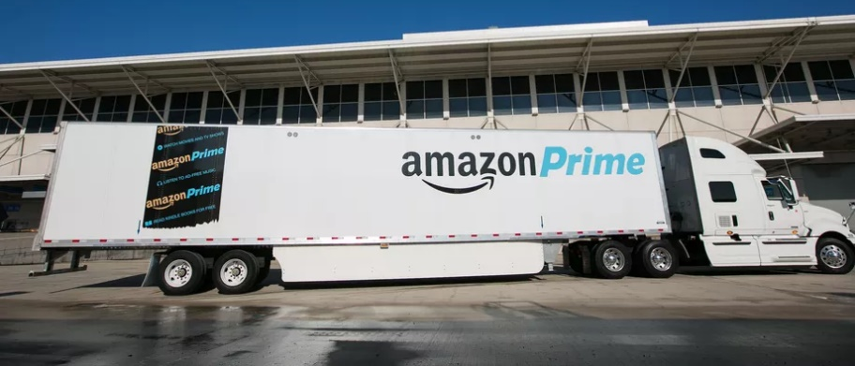
AMAZON SUPPLY CHAIN
-National Association of Manufacturers. 2020 Summary
https://www.nam.org/state-manufacturing-data/2020-kentucky-manufacturing-facts/
KIED IS ACCREDITED BY THE IEDC
Notes:
Revenue (Lead time, new product launch, on-time delivery, product quality and returns, fill rates)
Cost (Transportation, procurement, inventory, packaging, etc.)
Sales, General & Administrative ((Warranty, selling, transaction accuracy)
Inventory Days – Inventory Carrying Costs, obsolescence, forecast accuracy, sourcing and delivery time
A/R and A/P – Relationships with suppliers and customers, invoice terms, invoice accuracy
SCF – Measures cash cycle, impacted entirely by supply chain

Slide 29
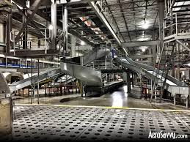
REASON #4 – LOGISTICS
UPS Worldport
Louisville, KY, 1999
Largest automated package handling facility in the world.
Amazon Air Hub
CVG, Northern Kentucky, 2021
$1.5 billion investment, 2,000+ jobs, one-day Prime?
KIED IS ACCREDITED BY THE IEDC
Notes:
Revenue (Lead time, new product launch, on-time delivery, product quality and returns, fill rates)
Cost (Transportation, procurement, inventory, packaging, etc.)
Sales, General & Administrative ((Warranty, selling, transaction accuracy)
Inventory Days – Inventory Carrying Costs, obsolescence, forecast accuracy, sourcing and delivery time
A/R and A/P – Relationships with suppliers and customers, invoice terms, invoice accuracy
SCF – Measures cash cycle, impacted entirely by supply chain

Slide 30
WHY YOU SHOULD CARE ABOUT DISTRIBUTION
New Supply Chain Companies
Trucking
Warehousing
3PL & Distribution
Technology
New Jobs
Skilled Labor
Product Agnostic
Reason #1: Network Effect
Better Distribution
More Manufacturing
KIED IS ACCREDITED BY THE IEDC
Notes:
Revenue (Lead time, new product launch, on-time delivery, product quality and returns, fill rates)
Cost (Transportation, procurement, inventory, packaging, etc.)
Sales, General & Administrative ((Warranty, selling, transaction accuracy)
Inventory Days – Inventory Carrying Costs, obsolescence, forecast accuracy, sourcing and delivery time
A/R and A/P – Relationships with suppliers and customers, invoice terms, invoice accuracy
SCF – Measures cash cycle, impacted entirely by supply chain

Slide 31
THANK YOU
Randy Siever
randy@novintu.com
KIED IS ACCREDITED BY THE IEDC

