Slide 1


Jennifer Kirchner
Executive Director
Many Modes of
Transportation
One Way Forward
Naashom Marx Senior Manager, Strategic Innovation
Why #KBT4AllModes
What If… UAM
Motivate to Modernize

Slide 2

OUR MISSION
Kentuckians for Better Transportation is the voice to educate and advocate for a safe and sustainable multi-modal transportation network that provides mobility across the Commonwealth for economic growth and improved quality of life.
MOBILITY
the potential for movement and the ability to get from one place to another using one or more modes of transport to meet daily needs INTEGRATION CONNECTION

Slide 3
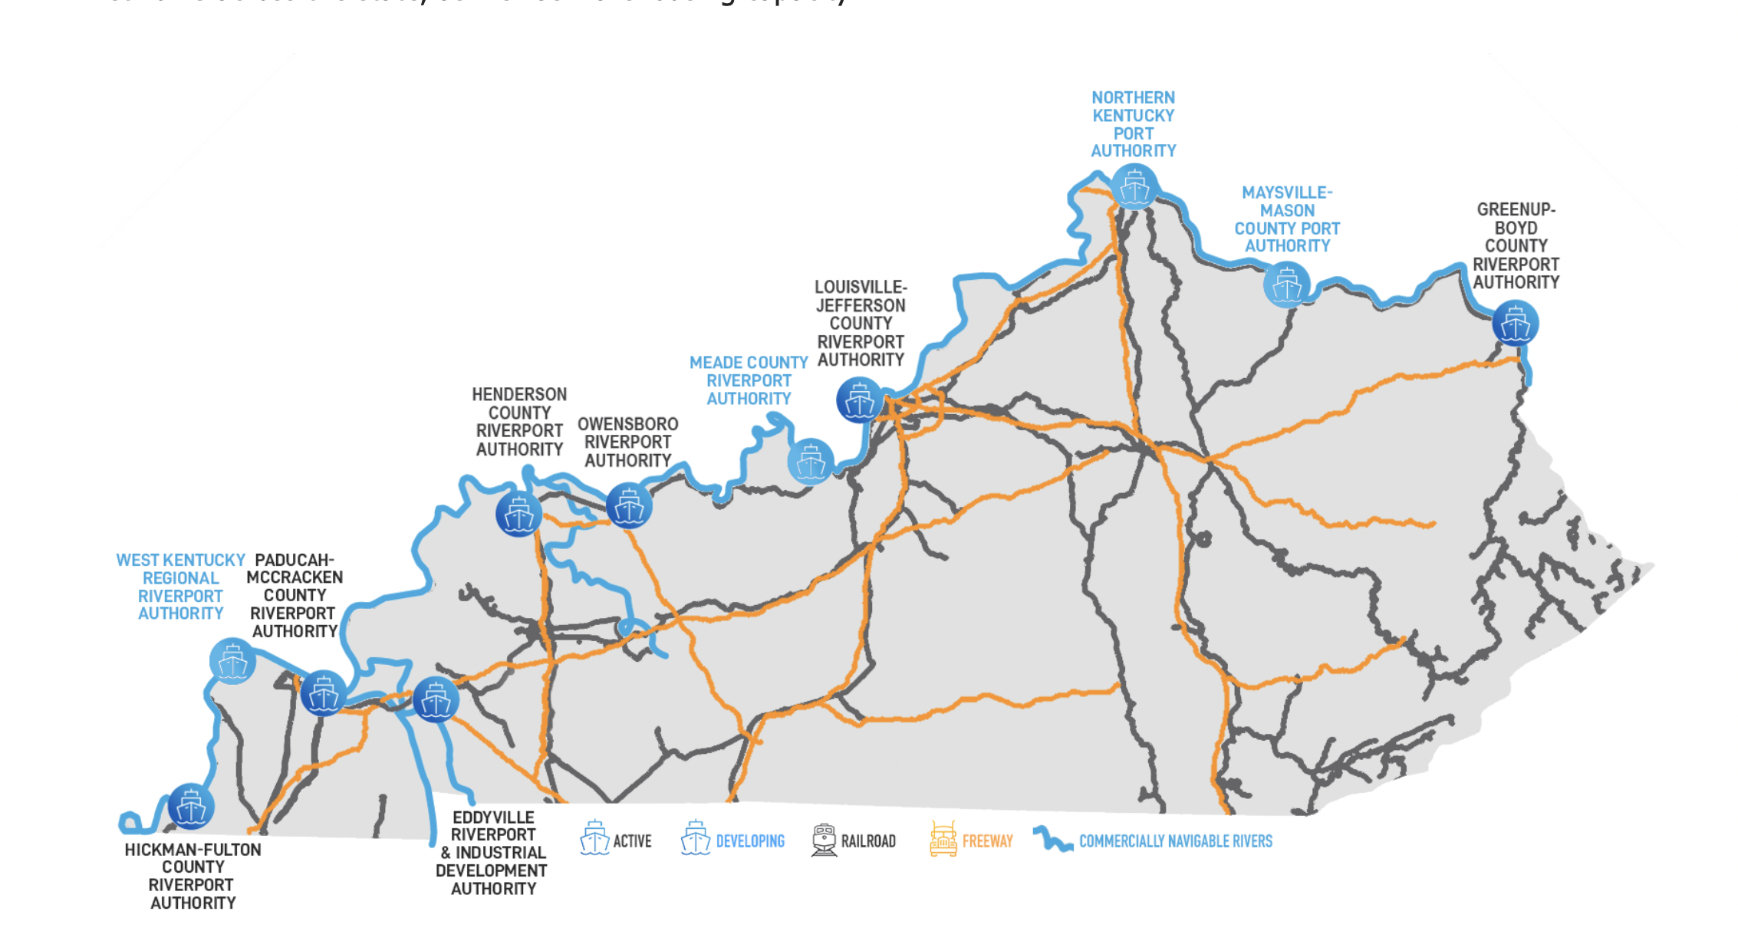
The Staggers Act 1980
Kentucky Riverports, Highway and Rail Freight Study KYTC is preparing an economic development plan to leverage the Ohio River corridor as well as other freight and rail assets.
1,100 navigable inland waterway miles and connections to the Great Lakes, Canada, and Mexico.
More than 4,100 Kentuckians are employed in the freight rail industry. Each freight rail job supports 4.5 jobs elsewhere in the economy.
Cargo moving through the state: 2019 400,000+ carloads originating in the state (over 27 million tons of traffic) versus just under 300,000 carloads terminating in state (22 million tons).

Slide 4
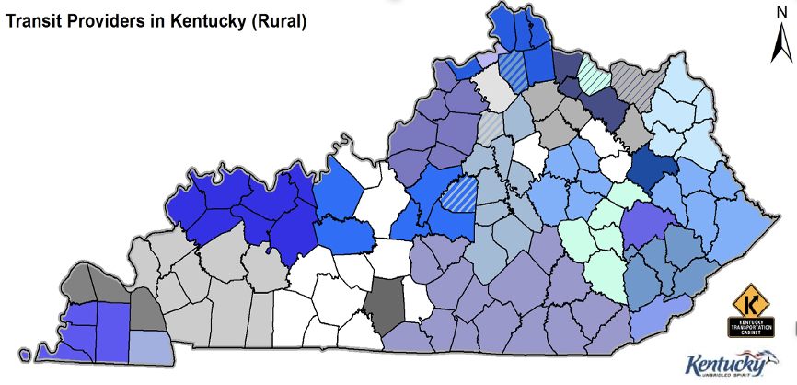
CURRENT KY
ROADWAY
FATALITIES
FOR 2021
Public transit operates in nearly every county in Kentucky!
SAFETY
632
Kentucky’s public transit bus systems provides approximately 31 million transportation passenger trips annually.
Almost 3 million trips per year are for the elderly and persons with disabilities, transporting them for medical treatment and other needed services.
Additionally, public transit routes for commuters, whose primary purpose is employment, operate throughout the state of Kentucky.

Slide 5

80,000 miles of roadway
14,000 bridges
Kentucky’s transportation funds total approx. $1.7 – 1.8 billion annually
$ Road Funds 63.0
$ General Funds 0.3
$ Restricted Funds 6.0 %
$ Federal Funds 30.7 %
Kentucky State Road Funds INCOM
Motor vehicle usage tax
  Vehicle and boat registration
  Motor vehicle operator’s licenses
  Motor fuels tax , Tolls, Interest
Kentucky State Road Fund Usage
Road construction, Maintenance, operations, engineering, planning, and research, many of the administrative functions within the KYTC.
HIGHWAYS
BRIDGES
LOCAL ROADS

Slide 6



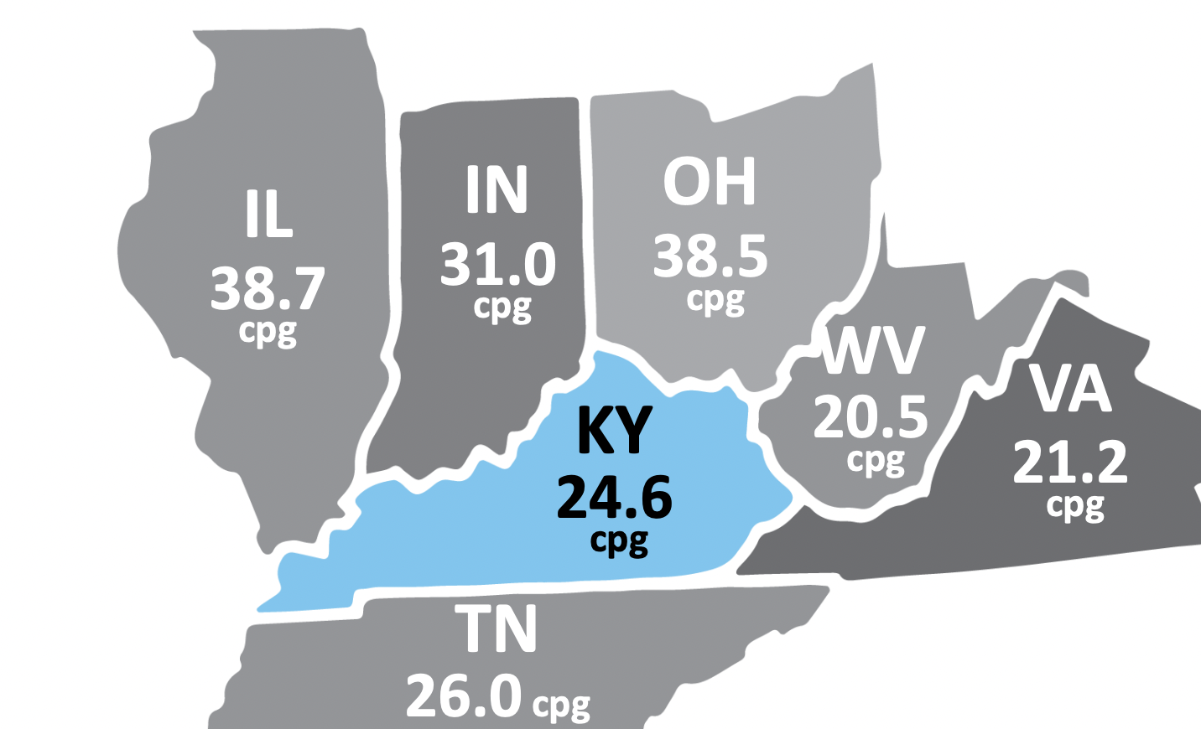
WE
SUPPORT
  KBT Urges the General Assembly to
  Increase the motor fuel user fees
  Implement a user fee system for low consumption vehicles in order to provide a sustainable funding stream
  Upcoming Session- Potential effects of IIJA- Match? Maintenance? Tax reform?
  VMT- preparing for what’s next
Removing non-construction and non-maintenance related activities from the Kentucky Road Fund
Adjusting all current user fees, including the motor fuels tax rate, to compensate for declines in revenue due to decreases in the average wholesale price of fuel, mandated fuel efficiency standards (CAFÉ), and inflation
Allowing the use of State Tax Increment Financing for transportation and other infrastructure projects
GAS TAX INCREASE

Slide 8



  Commercial Airports depend on a mixture of federal funds and funds obtained through charges for services provided and serve over 14 Million passengers yearly.
  Tax and job generators: 136,000+ jobs $480M tax revenue(CVG, SDF only)
  General Aviation airports (59) depend on limited federal funds, state funds derived from the sales tax on aviation fuels, and funds obtained through charges for the services they provide.
  Unmanned Aerial Systems (UAS)
14 Million passengers
136,000+ jobs
Total Annual Impact
CVG, LEX, SDF
$18,270,323,277

Slide 9

OPPURTUNITY: LOGISTICS and A GLOBAL ECONOMY
KY TRANSIT NETWORK WINS
Why move your business to KY?
LOCATION LOCATION LOCATION
We’re in the middle of everything!
1 day’s drive of two-thirds US pop. And within 600 miles of over 65 percent of the nation’s population
Located at the center of a 34-state distribution area in the E US
2nd in the nation in total air cargo shipments
2 international airports
3 global shipping hubs
Kentucky can get anywhere in the world virtually overnight.
A COMPETATIVE
KENTUCKY

Slide 10
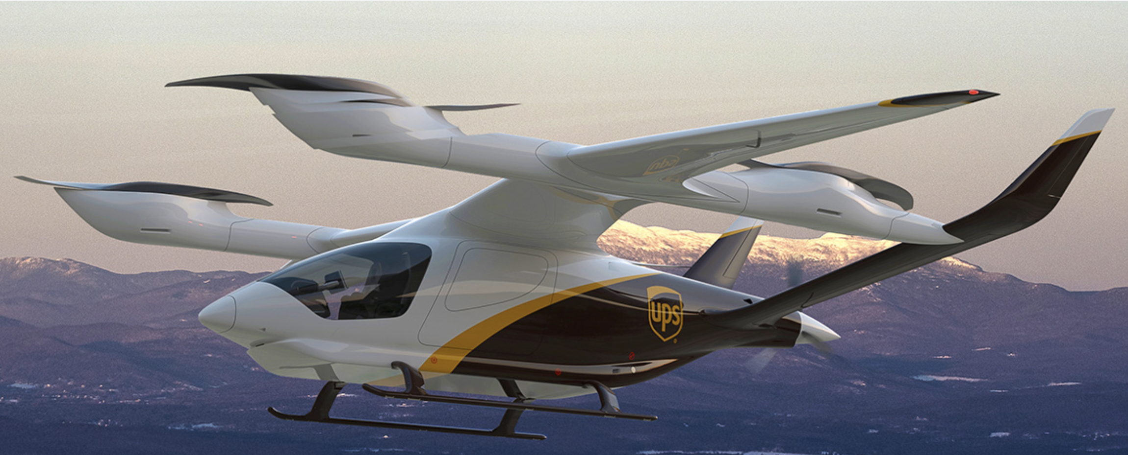
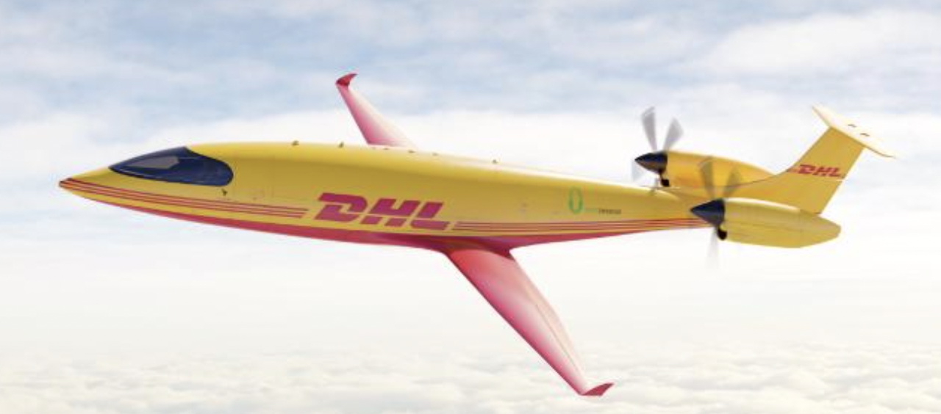
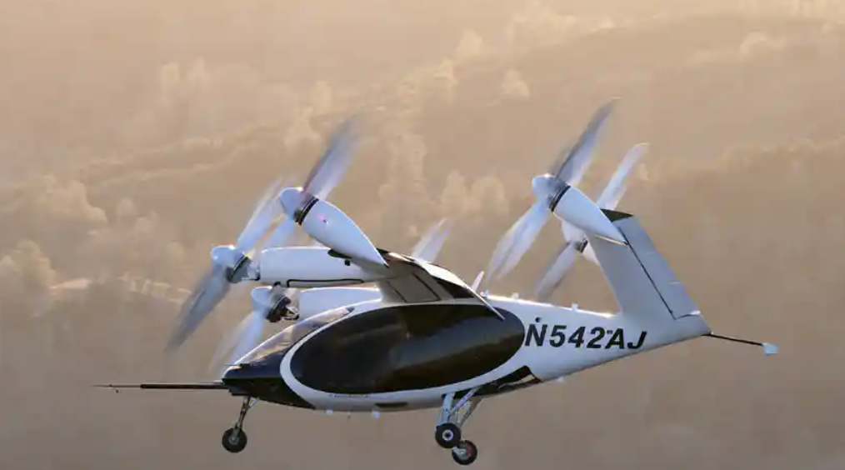
Economic Disruptor
Can be explained as the convergence of Technology and a new product that then creates a new market and destroys or radically transforms an existing industry-- Uber/taxi; digital/film
Urban Air Mobility
Electric Vehicles
NOW modernize transportation infrastructure funding
VMT/RUC
Ride Sharing* Gas in decline
Environmental Concerns
Surface Transportation System Funding Alternatives Program (STSFA)
Batteries
EVs
Autonomous Vehicles
Technology
The Electrification Of Transportation
ECONOMIC DEVELOPMENT & QUALITY OF LIFE

Slide 11
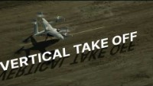

Notes:
I want to paint the picture of a few journeys that can happen here in Kentucky. You can wake up and have your cup of coffee overlooking the Red River Gorge before heading to your local vertiport. This vertiport could be nothing more than a helipad or a more complex system. There you meet some colleagues and begin your 40-minute journey to your office in Louisville for $45. Your family can live in your hometown, and you bring back that paycheck to spend in your hometown creating generational wealth.
Or another real-life situation where there is a medical emergency and a life saving medical device is brought to the trauma patient instead of the other way around resulting in a better medical experience.
Beyond jobs and medical there are those opportunities to get goods and people faster to and from the regional larger airport making the entire world that much more accessible to everyone.

Slide 12

The Challenge
A transportation system that is sustainable, efficient, affordable
Surface traffic operations costs: $12 billion/year*
  Urban traffic congestion costs: $4.6 billion/year
  Safety costs: $3.9 billion/year
Vehicle traffic increasing (8% since 2000 vs. population up 3%)
* Modernizing Ohio’s Transportation System: Progress and Challenges in Providing Safe, Efficient and Well-Maintained Roads, Highways and Bridges, TRIP, June 2018
Notes:
We can’t build enough roads fast enough and do we really want more roads?

Slide 13
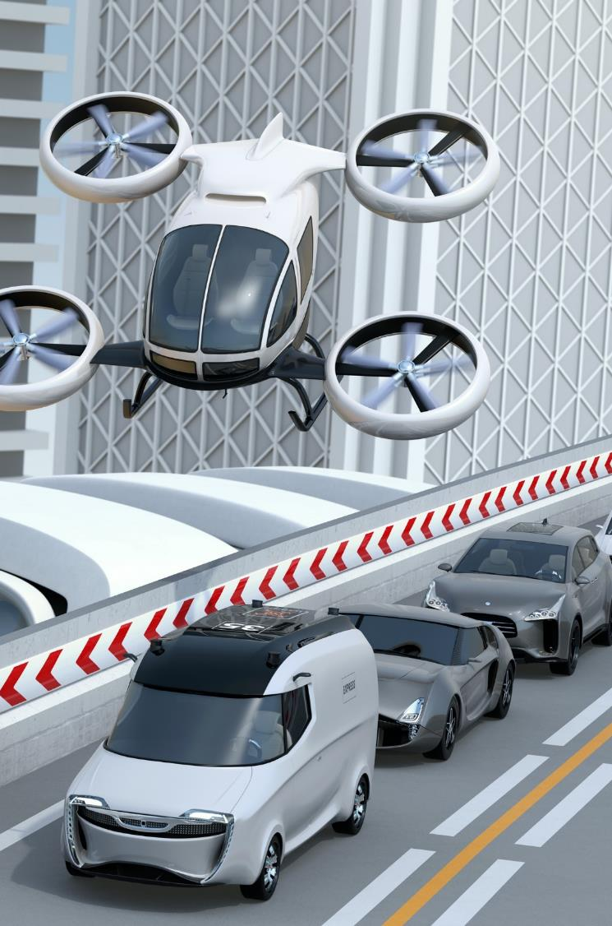
The Opportunity
Advanced Air Mobility (AAM)
Moves people and cargo between places not conveniently served by surface transportation and underserved by aviation.
Enables smart multimodal transportation connecting urban areas and regions
Notes:
Are there other options such as advanced air mobility?

Slide 14
Notes:
What is advanced air mobility? It is a mix of data collection and movement of goods and people combined with infrastructure.

Slide 15
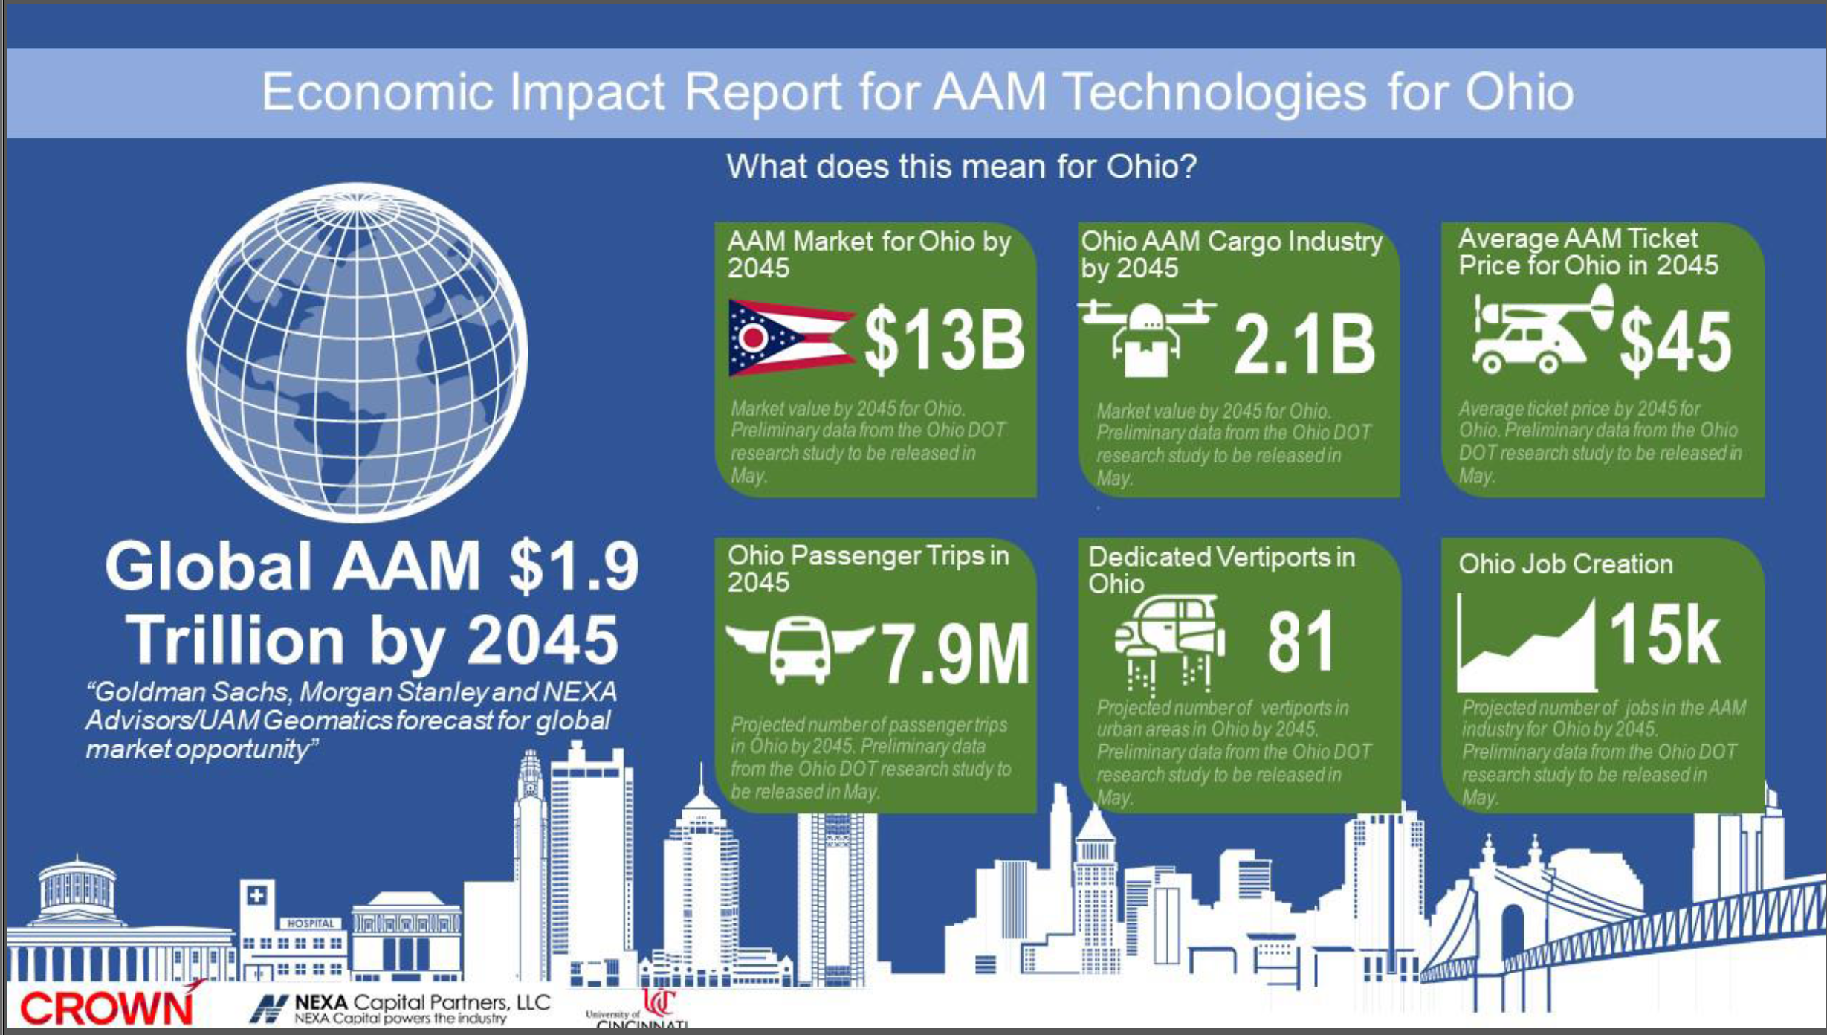
Ohio Economic Impact Study on Advanced Air Mobility. Crown Consulting, University of Cincinnati and NEXA Partners, July 2021
Notes:
Our neighbors to the north did a recent study around the impact that AAM could have for Ohio. These numbers clearly display not only that movement of goods and people – but jobs!

Slide 16
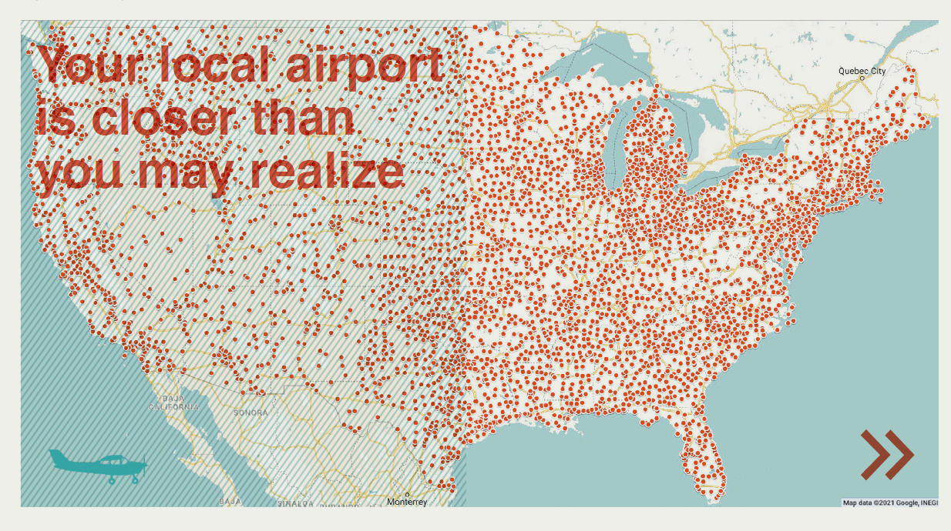
* Regional Air Mobility: Leveraging out National Investment to energize the American Travel Experience. NASA, April 2021
Notes:
The local airport you may have not even known existed will soon be the catalyst for how you travel. The opportunity to revitalize GA airports that can take you to larger international airports and city centers – as well as take people out of the cities and into your main streets is a true possibility.

Slide 17
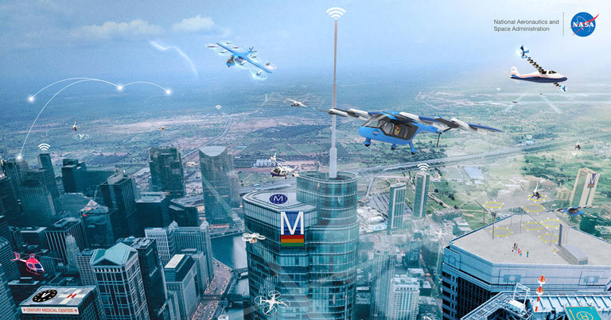
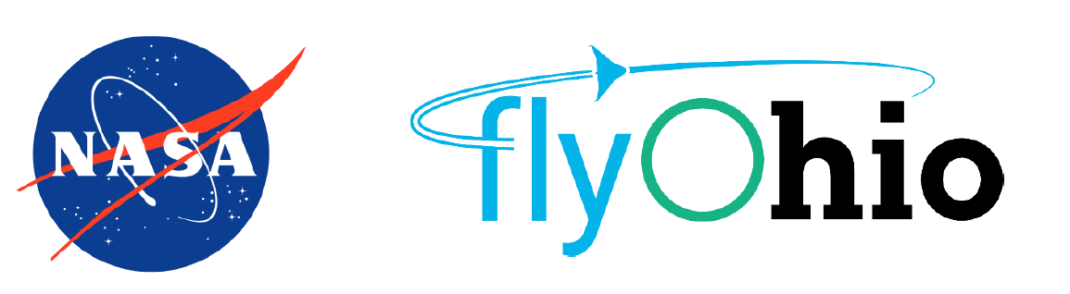






How is CVG involved with AAM?
Notes:
CVG recognizes where the industry is trending, and we are actively working with partners to test and create ways to lead this industry. Starting with joining the State Of Ohio in the NASA and FAA ACO3 project where we are one of 5 communities in the US to actively work on creating the playbook for advanced air mobility. We are also testing different ways to utilize VTOL data collection on our campus whether perimeter checks, pavement inspections or our upcoming studies with UK and the FAA on increment weather prediction. We are talking with our campus and global partners to ensure we are creating infrastructure that allows them to move cargo and people effectively. This is not just to get your CEO to their flight faster – this is to ensure there is equitable air space and a better way to be global yet local. Think medical, jobs and goods. That is what I think of when I think of Advanced Air Mobility.

Slide 18
Anticipate DISRUPTION> INVEST in General Aviation
Electric Aviation is now – low-cost infrastructure
BETA Technologies
Planning and Land Use
Revenue generator
Compatible development
Targeted marketing and recruiting
  DANVILLE- 22,000 operations/yr. -- 60 aircraft based
Job training sites/Workforce shortages– high paying
Cape Air-Work Forgiveness Programs – Owensboro
Bardstown- High School Aviation Education Program
“Why eVTOL developer Beta gives its employees free flight training”
eVTOL.com

Slide 19
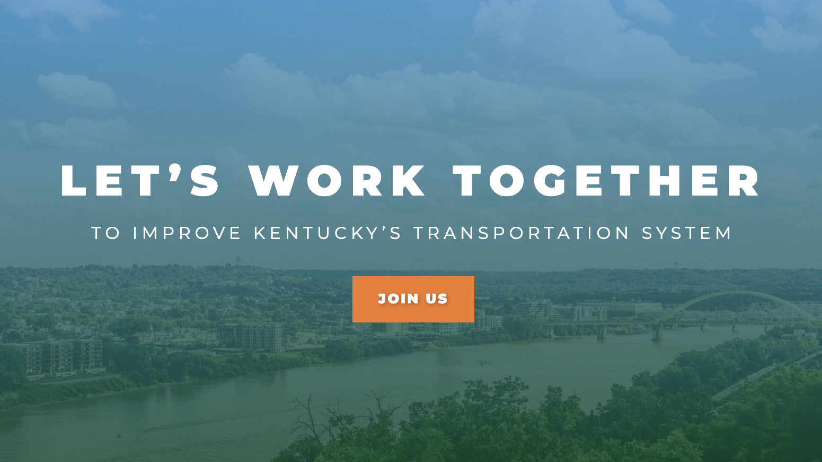
Jennifer@kbtnet.org
859-319-4902

