Slide 1
#workforcedev through remote access learning

Slide 2
About
Chief Officer, National Workforce Solutions, Career TEAM, LLC
Former President/CEO of the South Central Workforce Development Board (KY)
Workforce Tech Advocate
Practitioner focused on innovative program design and delivery to end generational poverty

Slide 3
Workforce Dev Orgs.
Mission in brief: To lead a highly-effective workforce development system for the 10 counites of south central, Kentucky in collaboration with business, economic development, education, and community organizations
10 county region population of about 350,000 people
Who are our customers? Career Seekers and Employers
Challenges: 1) Accessibility of our customers to services 2) Upward mobility of our career seekers
Solutions: 1) Affiliate site model 2) Career Edge technology
Vision: Move beyond traditional “bricks and mortar” career service delivery

Slide 4
Career EDGE Context
About three years ago, the SCWDB envisioned career services that transcended “bricks and mortar” delivery.
Increased accessibility in response to transportation, childcare, time of day barriers.
Modern way for customers to interact with our workforce system.
Standardization of service delivery.
Technology as a workforce systems integrator.
Scalability of staffing capacity.
In July 2018, the SCWDB launched Career Edge as a virtual career services platform for our region’s workforce system.
Remote access learning expands career services reach to home or phone.
Partner integration through access point model of service delivery (technology is the overlay for partnerships with high schools, public libraries, detention centers, career and technical centers, and food banks).

Slide 6
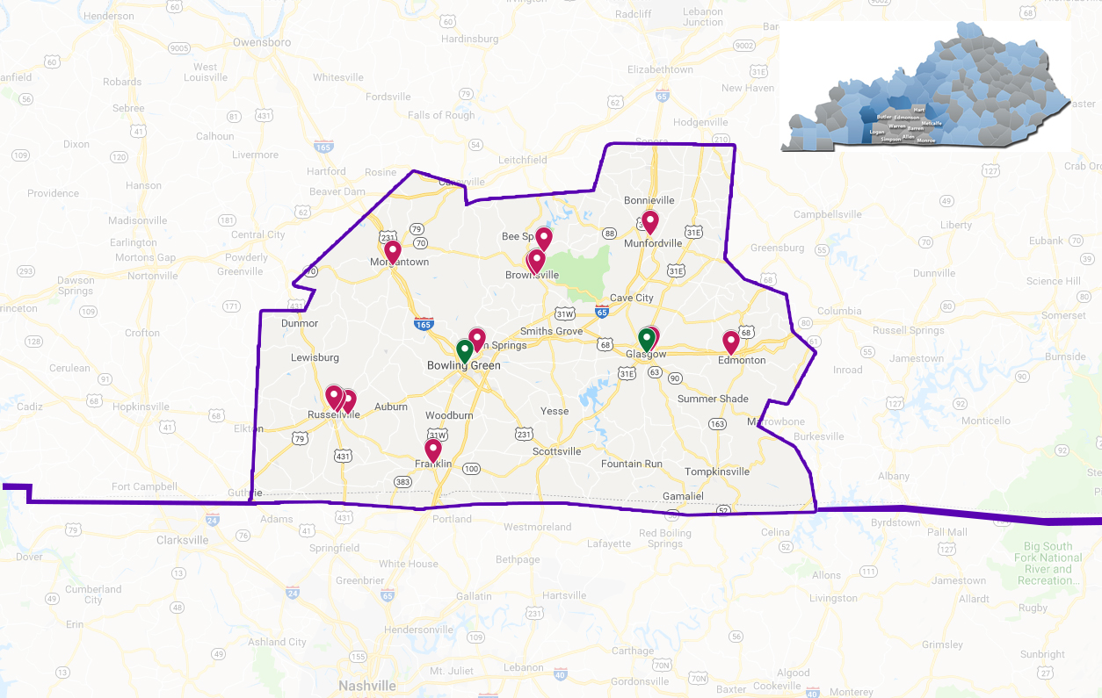

Slide 7
In October 2019, the SCWDB initiated a conversation with the KY Education and Workforce Development Cabinet about remote access learning. By April 2020, Career Edge was funded for all 120 counites of the state. The SCWDB developed the brand @kycareeredge (Facebook, Twitter, Instagram, and the URL www.kycareeredge.com). All 10 workforce boards can now begin using Career Edge through personalized URL’s.

Slide 8
Post COVID-19 #workforcedev Paradigm shift in: how skills development is scaled how customers prepare for the world of work how the workforce system interacts with customers

Slide 9
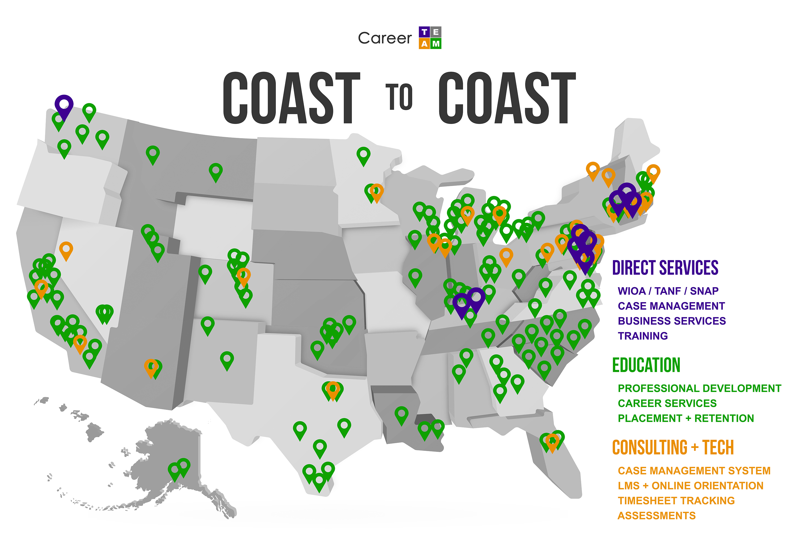

Slide 10
Career EDGE Success

Slide 11
Questions?
Robert Boone robert@careerteam.com
(270) 935-0518

