Slide 1
Business Retention & Expansion
Software Platform

Slide 2
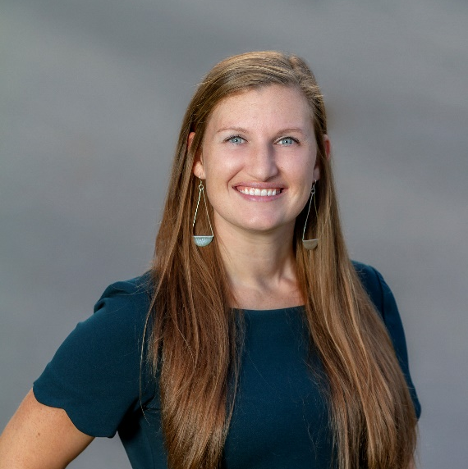
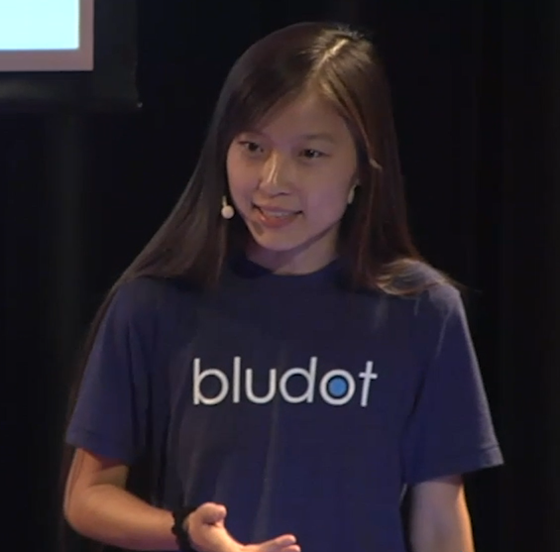
Beka Burton
Economic Development Specialist
CEDIK at University of Kentucky
Sophia Zheng
Founder/CEO
Bludot Technologies Inc.

Slide 3
Business Data
Map Visualization
Communication Wall
Targeted Group Post
Business Retention & Expansion
---
Connecting and Growing
Local Businesses

Slide 4
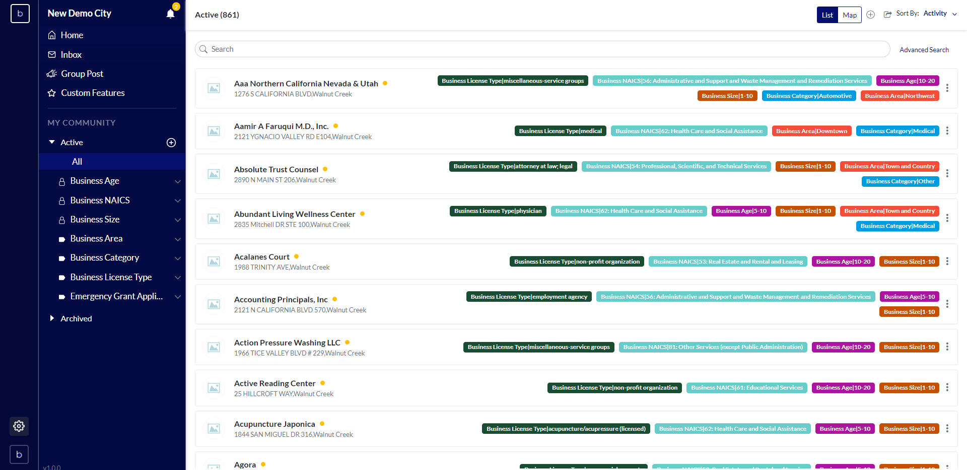

Slide 5
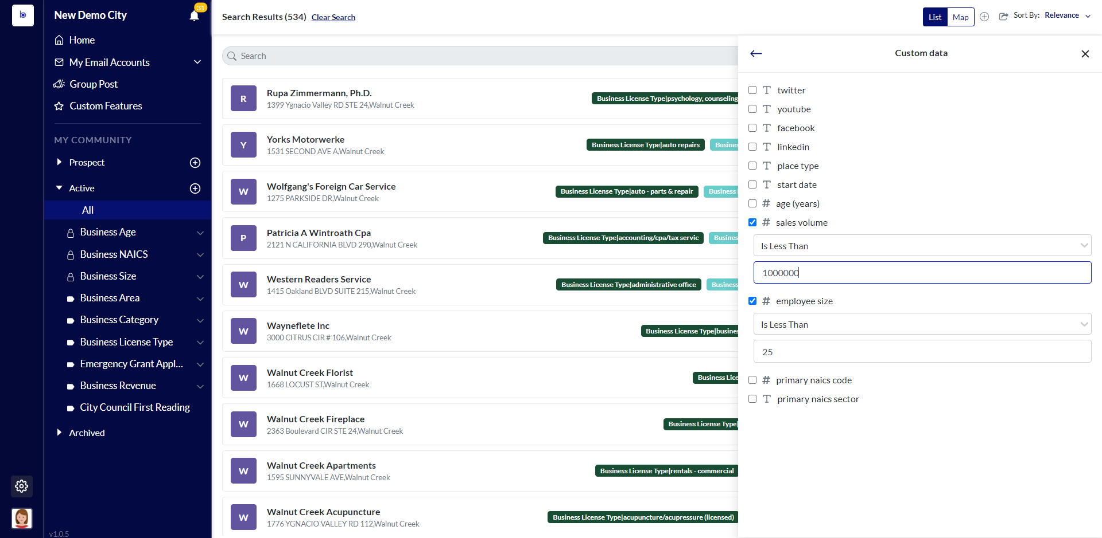

Slide 6
Business Data
Map Visualization
Communication Wall
Targeted Group Post
Business Retention & Expansion
---
Connecting and Growing
Local Businesses

Slide 7
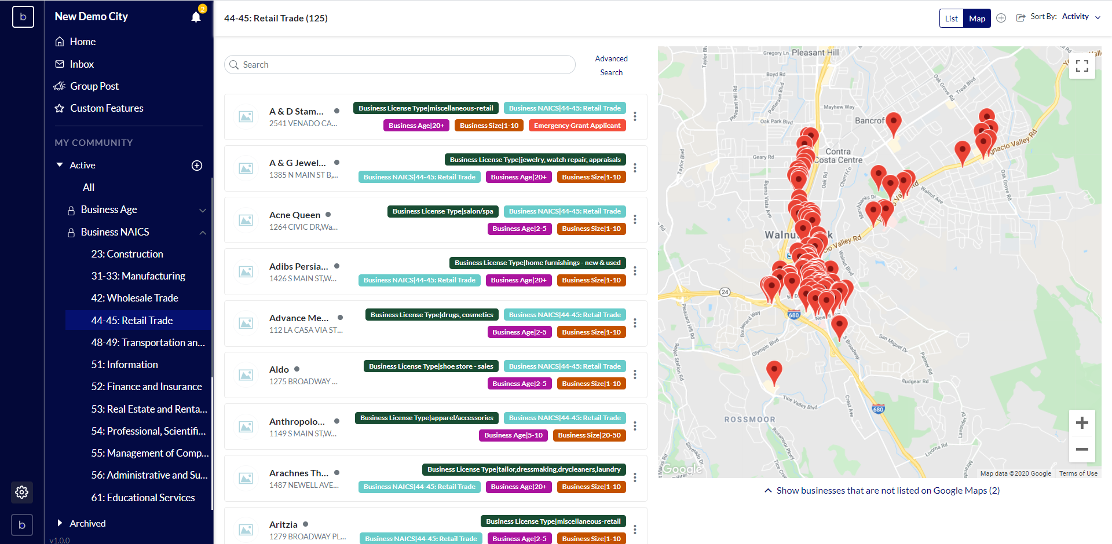

Slide 8
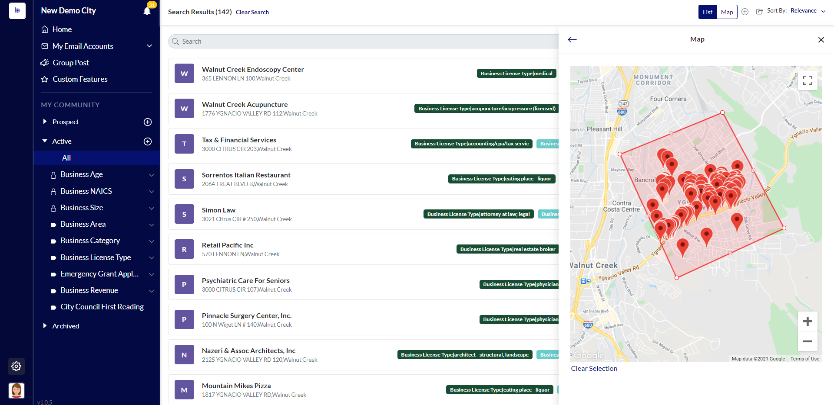

Slide 9
Business Data
Map Visualization
Communication Wall
Targeted Group Post
Business Retention & Expansion
---
Connecting and Growing
Local Businesses

Slide 10
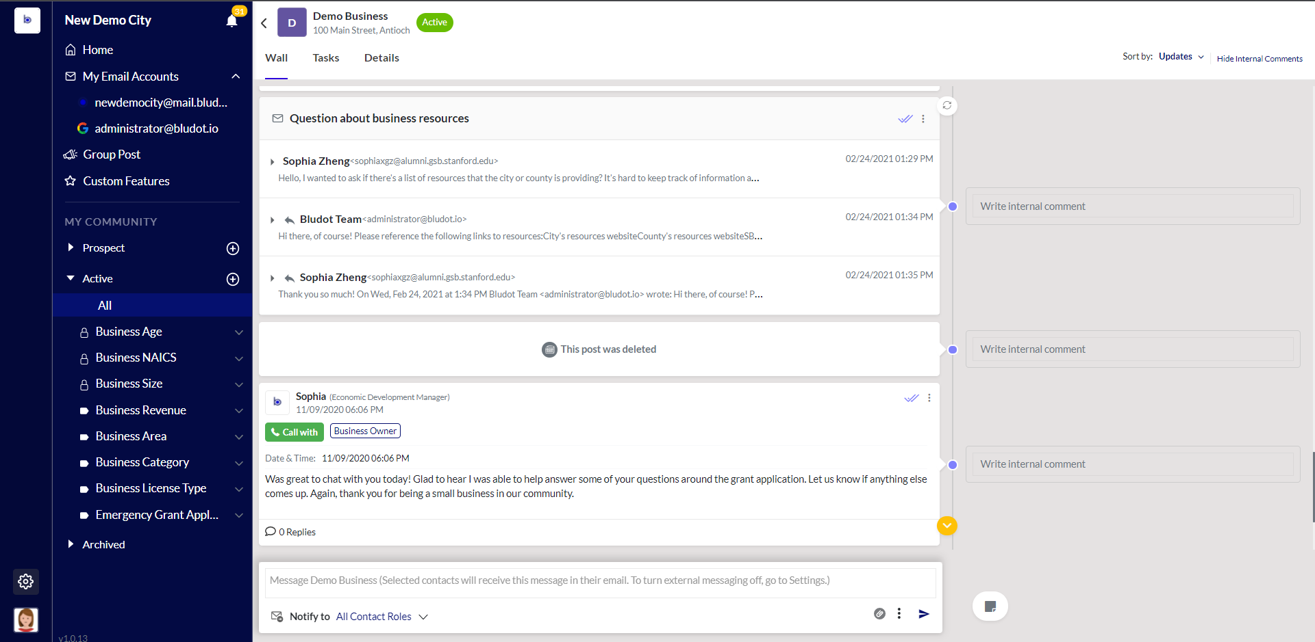

Slide 11
Business Data
Map Visualization
Communication Wall
Targeted Group Post
Business Retention & Expansion
---
Connecting and Growing
Local Businesses

Slide 12
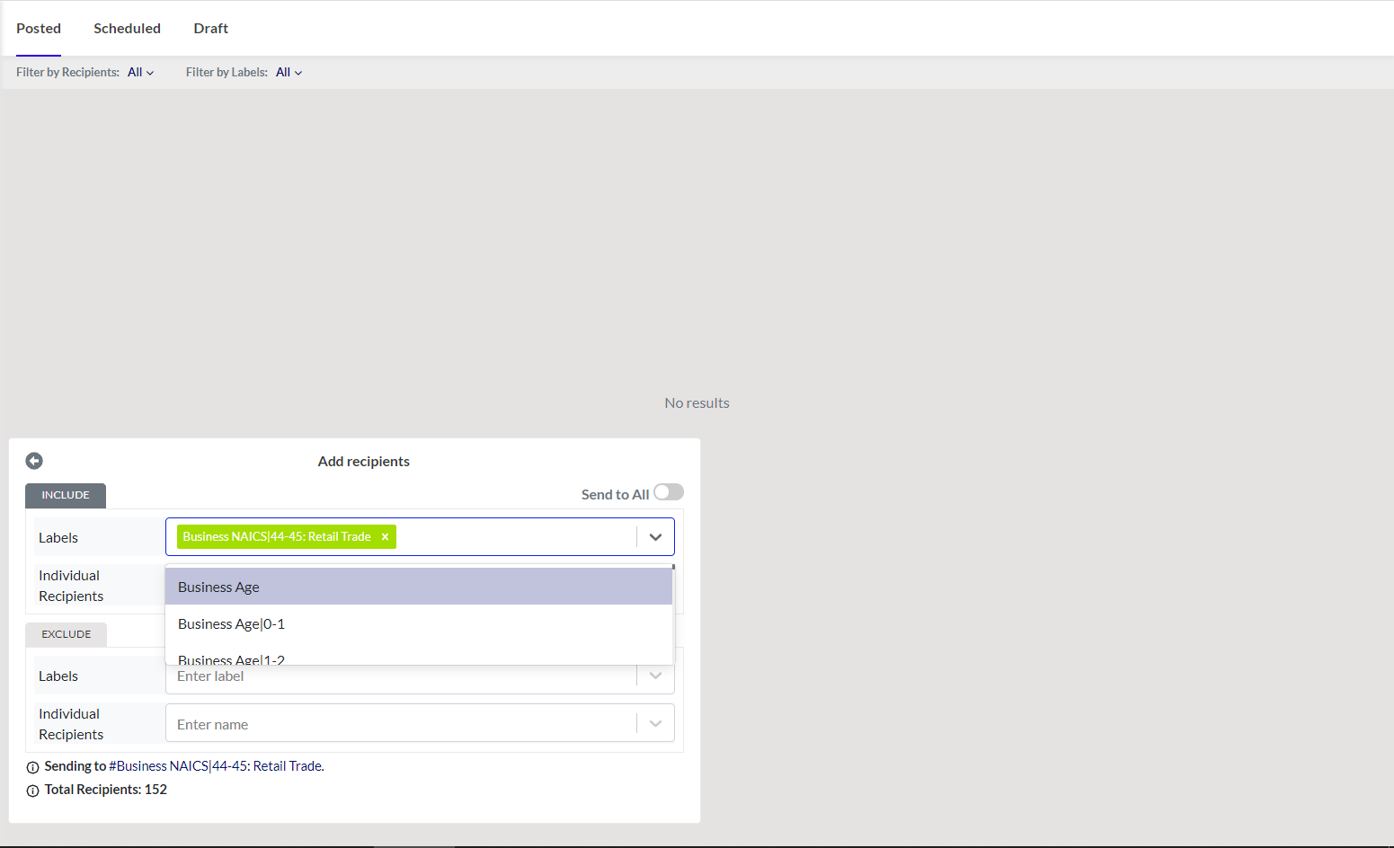

Slide 13
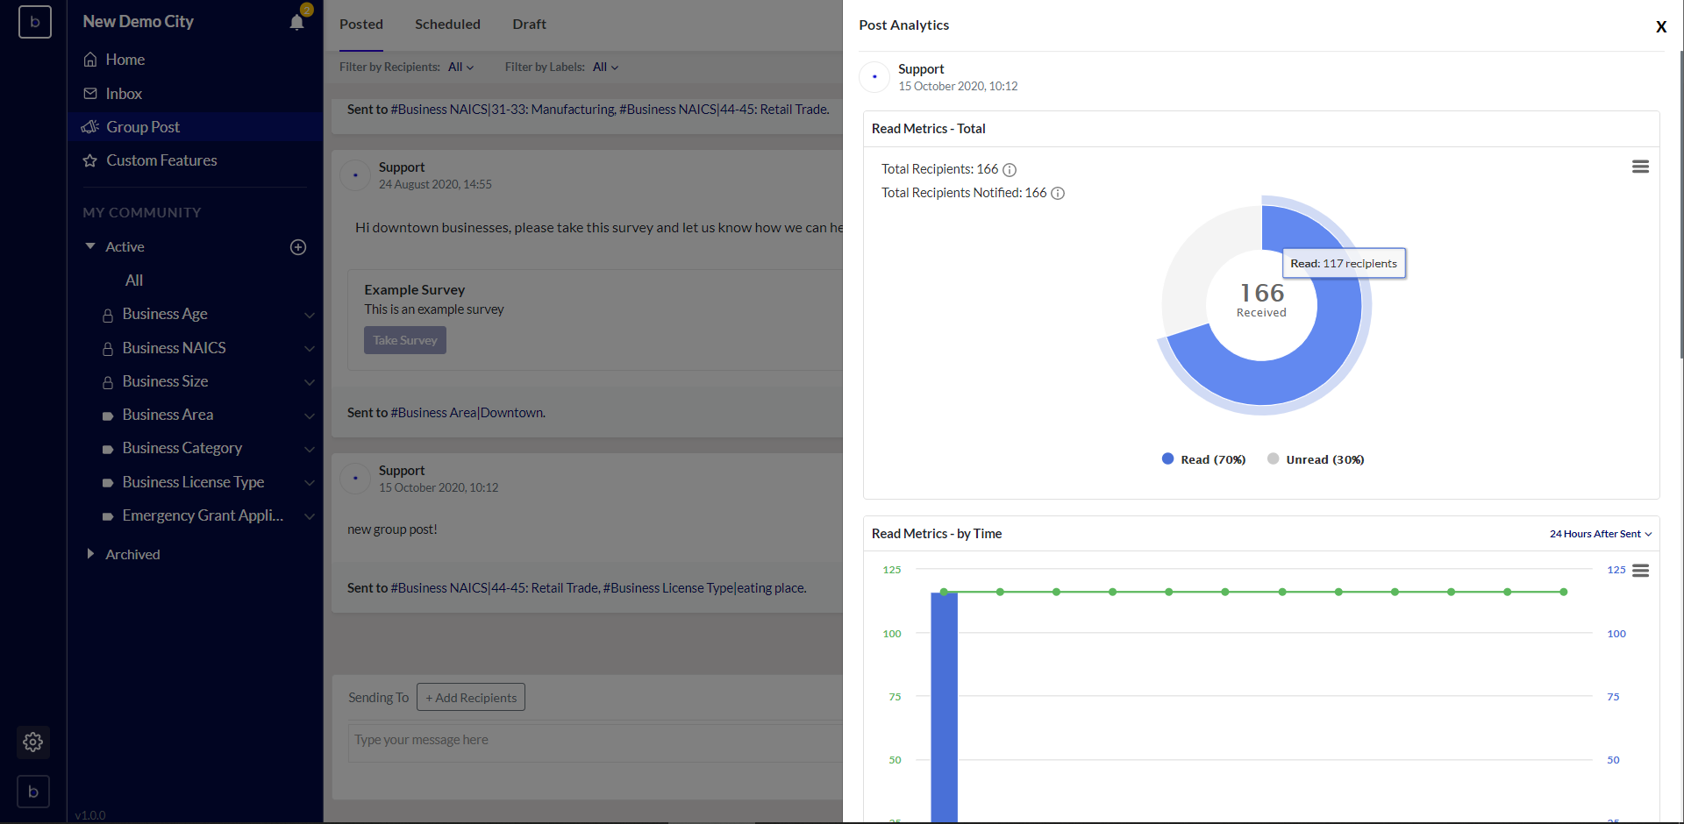

Slide 15
Sign up for
Bludot Onboarding Session
November 16th 11am ET
•
Contact us at
Beka Burton|beka.burton@uky.edu
Thank you!

