Slide 1
KENTUCKY CABINET FOR ECONOMIC DEVELOPMENT
KAED ANNUAL MEETING
November 2021

Slide 2
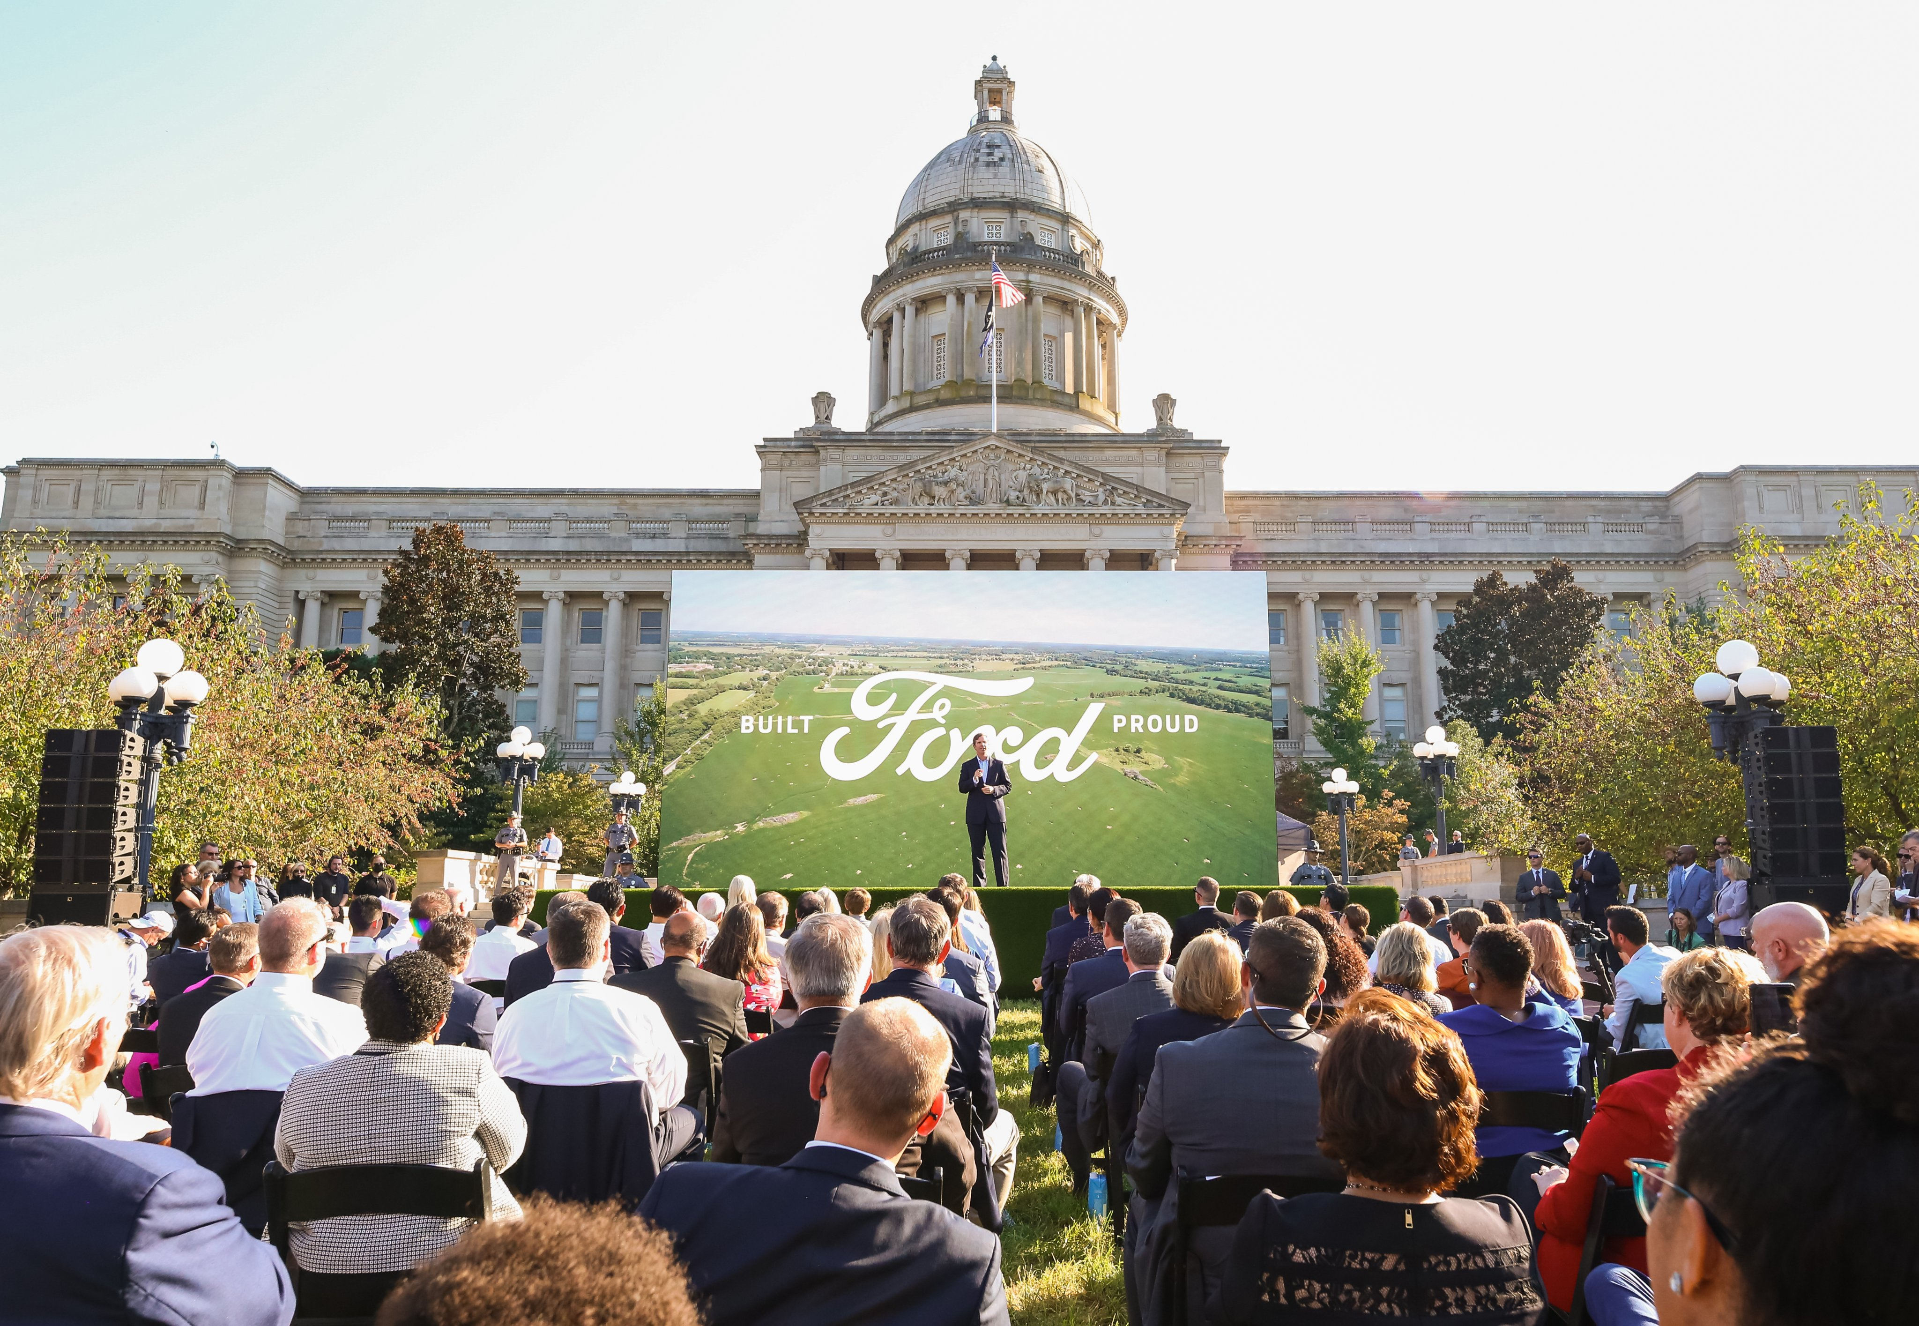
PROJECT PROFILE
BlueOvalSK
Glendale, Hardin County
Announcement of two EV battery facilities
5,000 full-time jobs
$5.8 billion investment

Slide 3
2021 YTD
15,200-plus new full-time jobs announced
100-plus private-sector expansion or new-facility-location projects announced
$
$10.3 billion announced investment, a new record
$24.15 average-hourly wage across incentivized jobs
3

Slide 4
WAGE GROWTH
A STRATEGIC PRIORITY
YTD in 2021, the average incentivized hourly wage are trending second-highest across the past seven years
Rank | Average Hourly Wage | Year Preliminarily Approved
1* | $28.38 | 2019
2 | $24.15 | 2021 YTD
3 | $21.93 | 2020
4 | $21.39 | 2017
5 | $20.94 | 2016
6 | $20.64 | 2018
7 | $19.96 | 2015
*Includes UPS pilots announcement, 1,000 jobs at $70 average hourly wage
4

Slide 5
TOP 5 INDUSTRIES – 2021 YTD
BY ANNOUNCED INVESTMENT
1. Automotive | $6.6B
2. Food, Beverage & Agritech | $1.0B
3. Metals | $965M
4. Business/Financial Services | $558M
5. Plastics & Rubber | $240M
BY ANNOUNCED JOBS
1. Automotive | 7,200
2. Business/Financial Services | 2,500
3. Metals | 1,700
4. Food, Beverage & Agritech | 1,100
5. Logistics & Distribution | 830

Slide 6
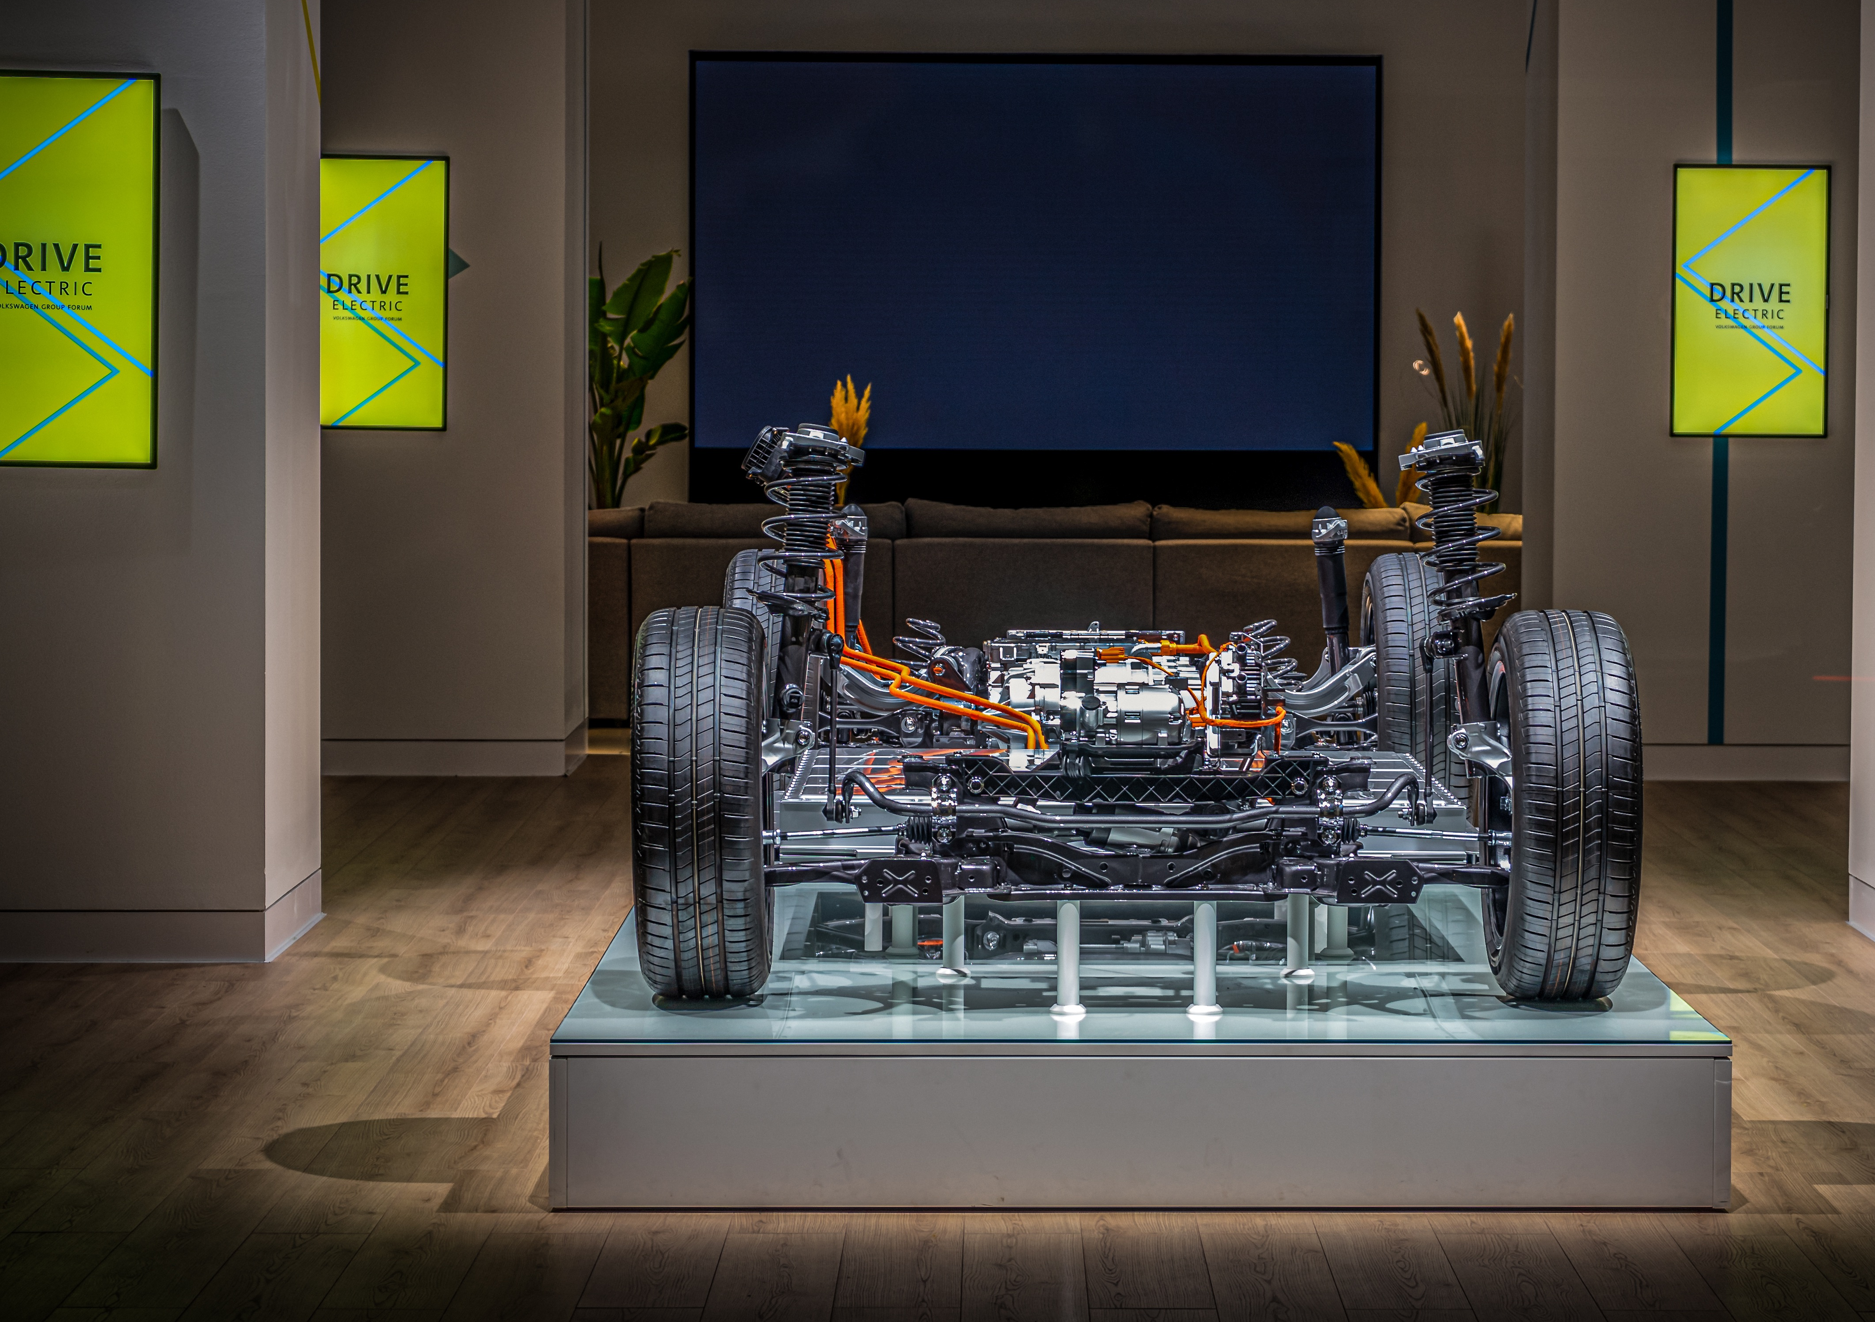
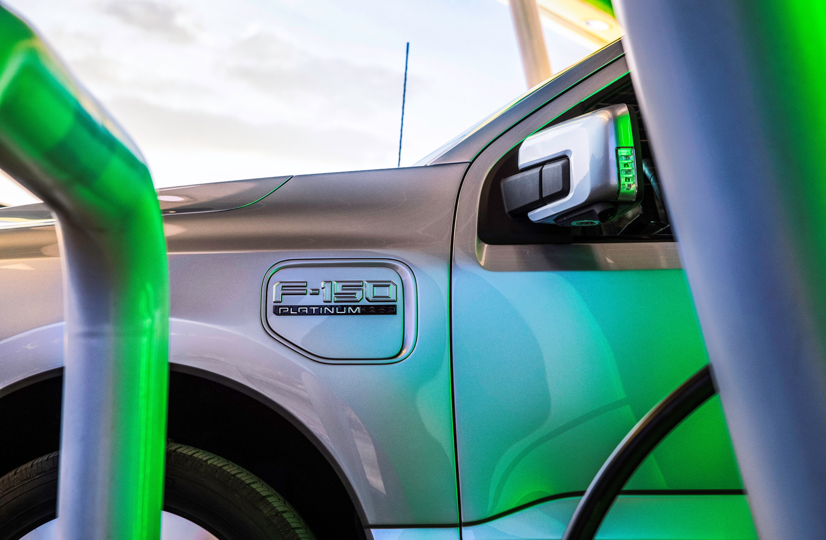
EV AND BATTERY PROJECTS
ATTRACTING THE U.S. SUPPLY CHAIN
ADVANTAGES
500+ auto suppliers and OEMs
240 metals-related facilities
Location at center of U.S. automaking corridor
Low industrial electric rates
NEEDS
Site development
Workforce development
6

Slide 7
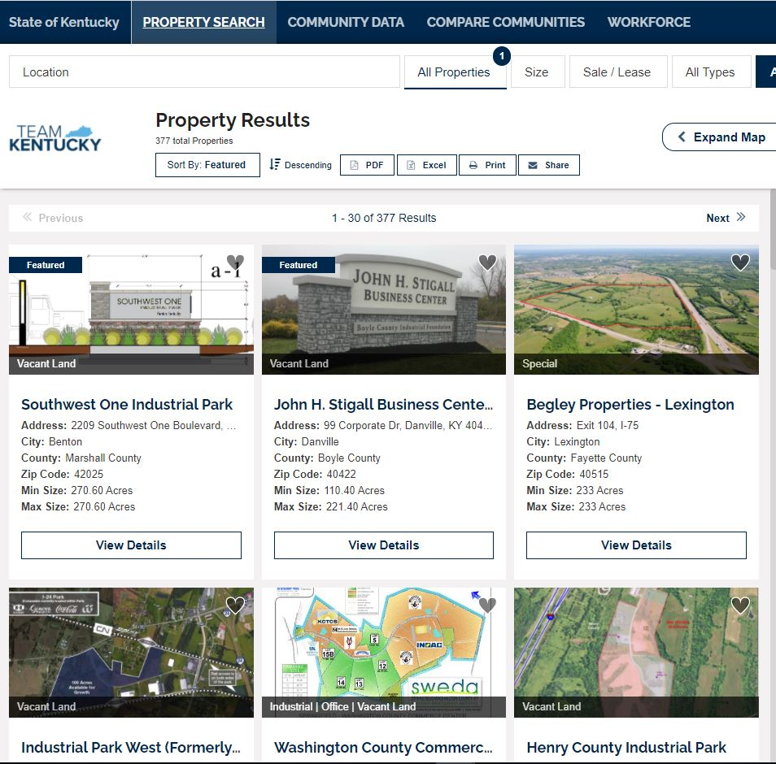
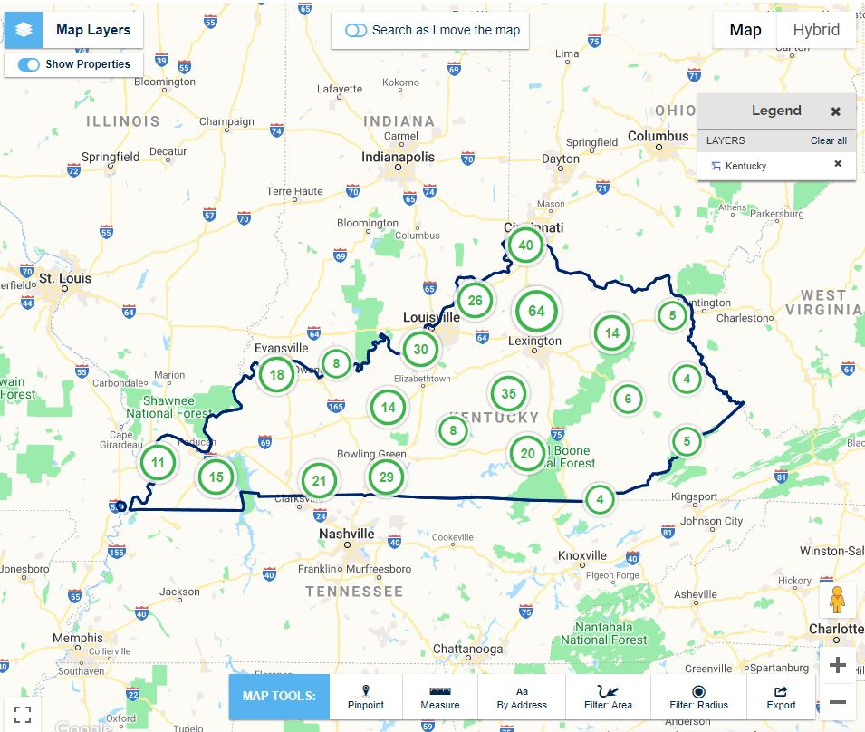
PREP IS KEY
MORE GRADE-A SITES & BUILDINGS
Team Kentucky is building on a statewide effort to:
Enhance existing large-scale sites
Identify new sites
Be the No. 1 state in speed-to-market
Attract large-scale creation of well-paying jobs

Slide 8
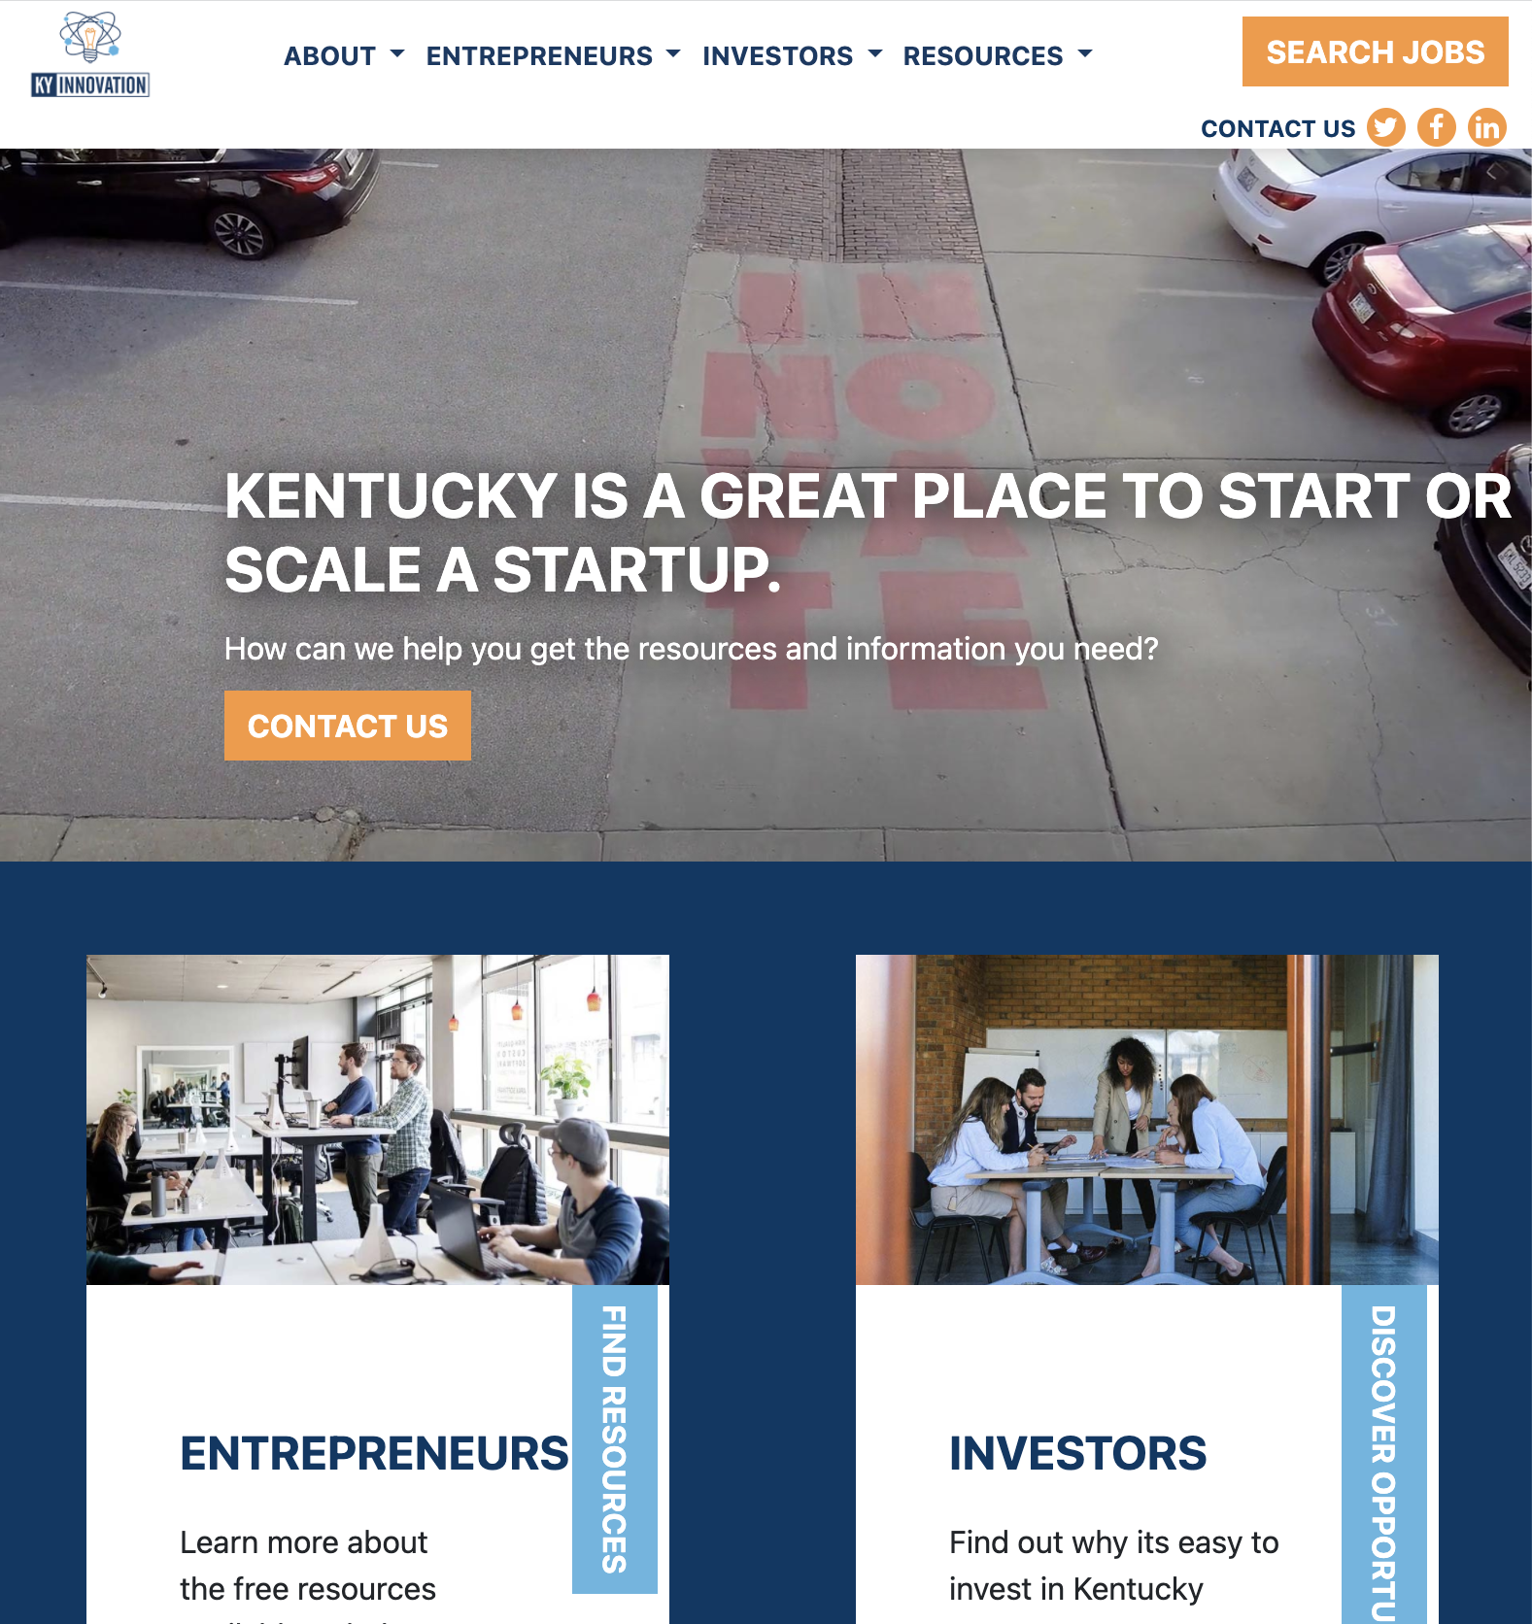
KY INNOVATION WEBSITE UPDATE LAUNCHED
KYINNOVATION.COM
Navigation: Dramatically improved user experience
Comprehensive: Info for entrepreneurs, investors and the public
Transparency: Metrics, annual reports
Team Kentucky’s Story: Richer content highlighting KY startup and entrepreneur successes and testimonials
Phase II: Will include talent attraction page/content and more investor data
8

Slide 9
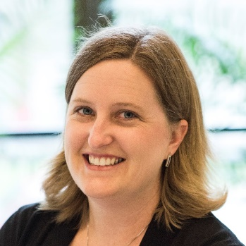
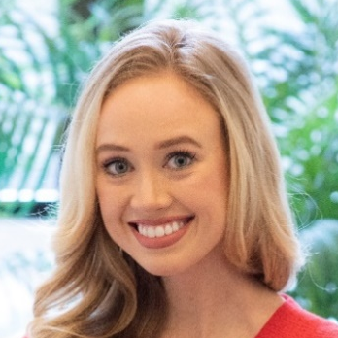
CED TEAM
PROMOTIONS
Katie Smith
Deputy Secretary
and Commissioner, Department for Financial Services
Brittany Cox
Senior Project Manager, Department for Business Development
Annie Franklin Senior Project Manager,
Department for Business Development
Sarah Butler
Deputy Commissioner,
Department for Financial Services
9

Slide 10
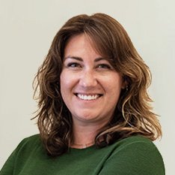
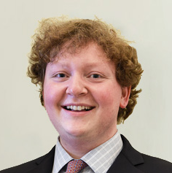
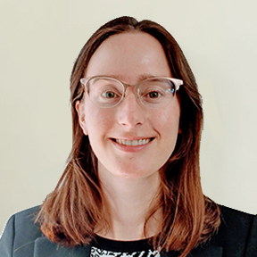
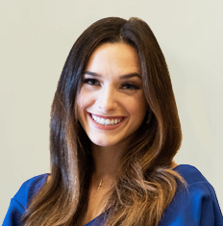
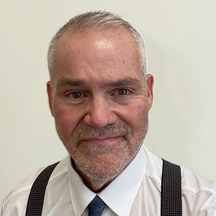
CED TEAM
NEW HIRES
Malcolm Jollie Project Manager, Department for Business Development
Matt Sims
Project Manager, Department for Business Development
Ashlee Chilton
Project Manager,
Department for Business Development
Foster Shrout
Project Manager,
Department for Business Development
Maurice Walker Executive Administrative Assistant,
Office of the Secretary
Danielle Goetz
Research Specialist,
Office of Research Department for Business Development
Alex Francke
Marketing and Communications Specialist,
Office of Marketing and Public Affairs
Dan Wood
Assistant Director of Compliance,
Department for Financial Services
10

Slide 11
THANK YOU
CED.ky.gov

